Slide 1
Inteligência artificial: a nova fronteira da ciência brasileira
Eduardo Bezerra (CEFET/RJ)
ebezerra@cefet-rj.br

Slide 2
Brief account of AI’s history

Slide 3
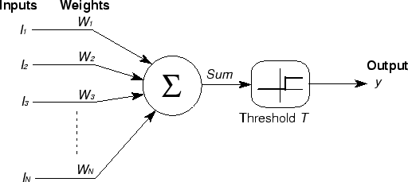
Artificial Neuron
McCulloch-Pitts model (boolean functions, cycles)
1943
Notes:
http://wwwold.ece.utep.edu/research/webfuzzy/docs/kk-thesis/kk-thesis-html/node12.html

Slide 4
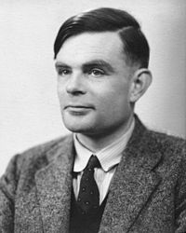
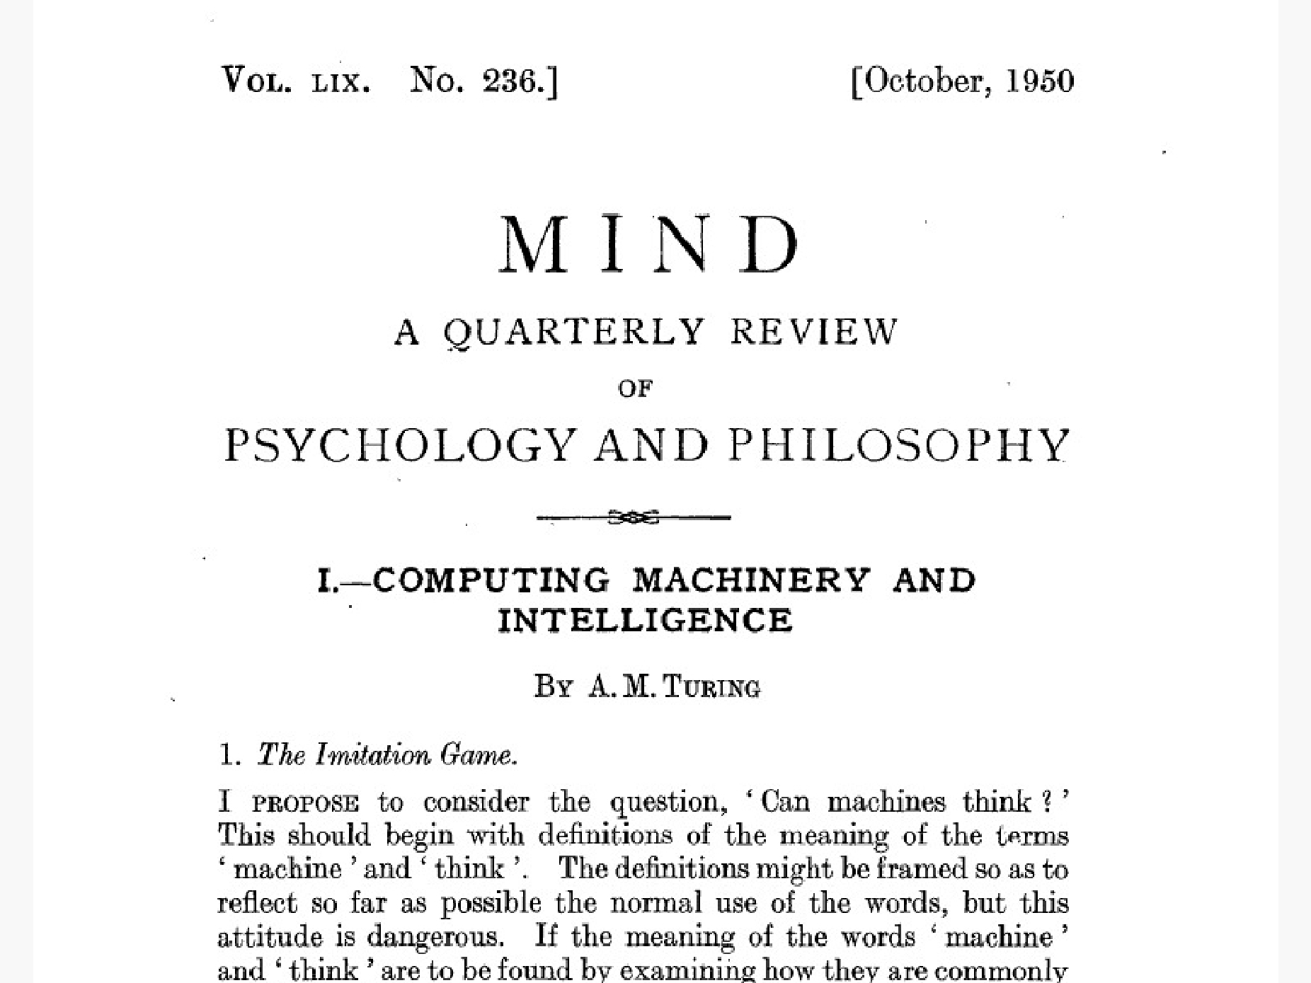
The Imitation Game
“I propose to consider the question, 'Can machines think?'”
1950
Alan Turing, 1912-1954
Notes:
Computing Machinery and Intelligence (1950)
http://mpcrlab.com/2016/09/turing-alan-m-computing-machinery-and-intelligence-1950/
Previsão: em 2000, máquinas poderiam se passar por humanos em mais de 30% das vezes.

Slide 5
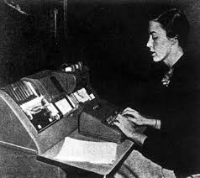
Georgetown-IBM experiment
Machine translation: automatic translation of Russian sentences into English.
“The experiment was considered a success and encouraged governments to invest in computational linguistics. The project managers claimed that machine translation would be a reality in three to five years.”
1954
Notes:
Quote from https://patriciahysell.wordpress.com/tag/georgetown-ibm-experiment/
https://en.wikipedia.org/wiki/Georgetown%E2%80%93IBM_experiment
http://www.hutchinsweb.me.uk/AMTA-2004.pdf
Automatic translation of more than sixty Russian sentences into English

Slide 6
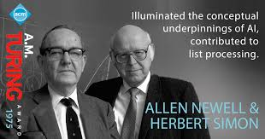
Logic Theorist
Proved 38 of the first 52 theorems in chapter 2 of the Principia Mathematica.
1956

Slide 7
Dartmouth meeting
John McCarthy, Claude Shannon, Marvin Minsky, ...
“We propose that a […] study of artificial intelligence be carried out […]. The study is to proceed on the basis of the conjecture that every aspect of learning or any other feature of intelligence can in principle be so precisely described that a machine can be made to simulate it. An attempt will be made to find how to make machines use language, form abstractions and concepts, solve kinds of problems now reserved for humans, and improve themselves.”
1957
Notes:
https://www.dartmouth.edu/~ai50/homepage.html
https://www.aaai.org/ojs/index.php/aimagazine/article/view/1904
Lisp, utility computing, garbage collection, time-sharing systems
“In August 1959 he proposed the use of recursion and conditional expressions, which became part of ALGOL.”

Slide 8
High hopes
“It is not my aim to surprise or shock you –but … there are now in the world machines that think, that learn and that create. Moreover, their ability to do these things is going to increase rapidly until –in a visible future – the range of problems they can handle will be coextensive with the range to which human mind has been applied. More precisely: within 10 years a computer would be chess champion, and an important new mathematical theorem would be proved by a computer.
--Herbert Simon
1957

Slide 9
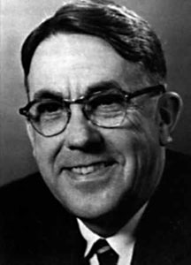
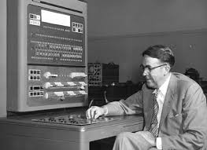
Machine Learning (to play Checkers)
Coined the term Machine Learning (“Field of study that gives computers the ability to learn without being explicitly programmed.”)
“it will learn to play a better game of checkers than can be played by the person who wrote the program.”
search tree
alpha-beta pruning
scoring functions
1959
Arthur Samuel
Notes:
https://history-computer.com/ModernComputer/thinkers/Samuel.html
https://en.wikipedia.org/wiki/Arthur_Samuel#Computer_checkers_(draughts)_development
TeX programmer

Slide 10
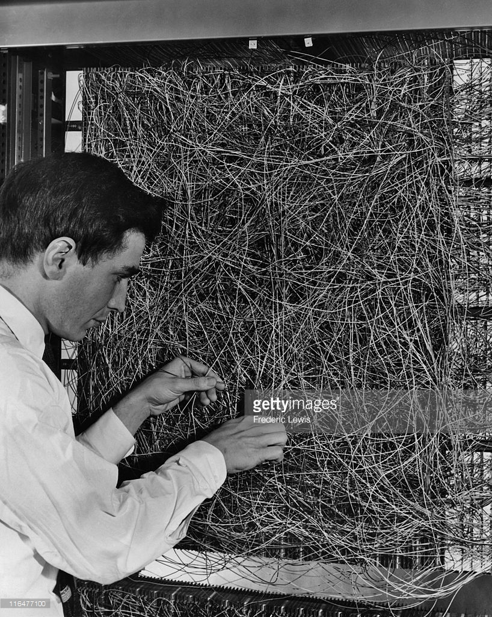
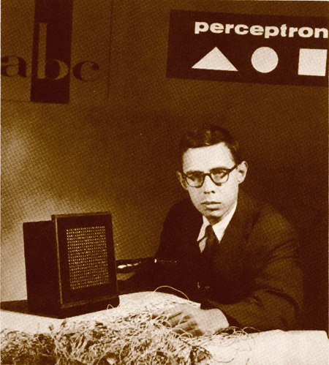
Mark I Perceptron
NY Times: “the embryo of an electronic computer that [the Navy] expects will be able to walk, talk, see, write, reproduce itself and be conscious of its existence.
1960
Frank Rosenblatt
Notes:
https://www.dartmouth.edu/~ai50/homepage.html
https://www.aaai.org/ojs/index.php/aimagazine/article/view/1904
Rosenblatt, with the image sensor of the Mark I Perceptron (Source: Arvin Calspan Advanced Technology Center; Hecht-Nielsen, R. Neurocomputing (Reading, Mass.: Addison-Wesley, 1990).)
https://blogs.umass.edu/comphon/2017/06/15/did-frank-rosenblatt-invent-deep-learning-in-1962/
https://blogs.umass.edu/brain-wars/files/2016/03/rosenblatt-1957.pdf

Slide 11
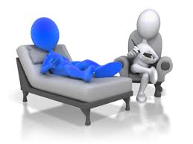
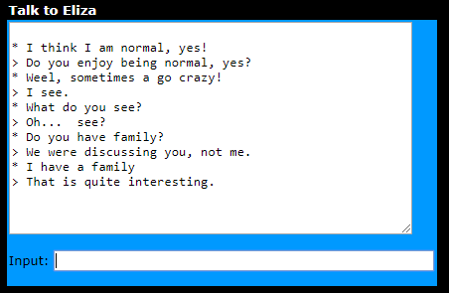
ELIZA
“Natural language” conversation.
“...sister...” → “They me more about your family.”
1966
Notes:
https://www.csee.umbc.edu/courses/331/papers/eliza.html

Slide 12
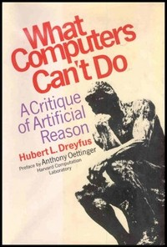
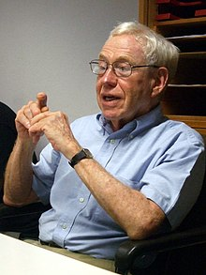
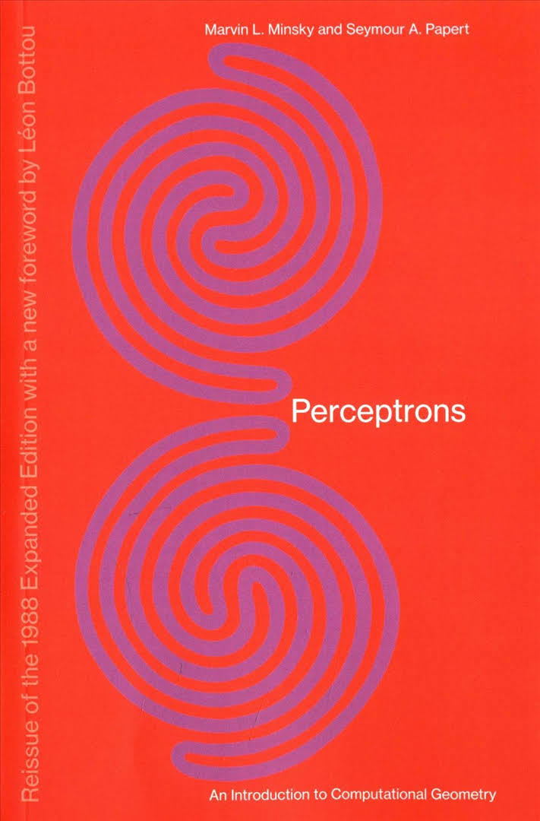
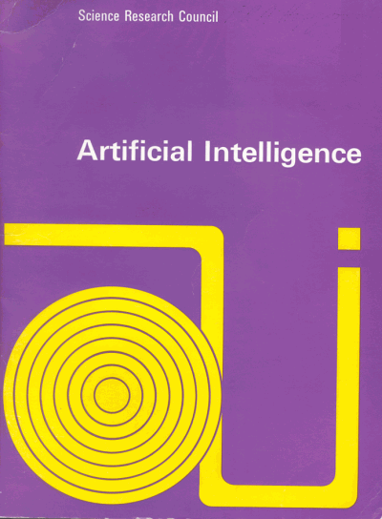
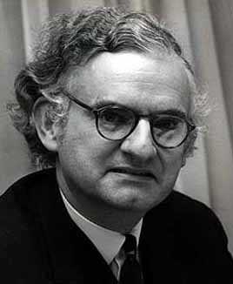
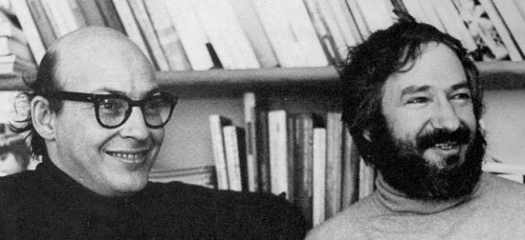
Winter is coming…
1969
1972
1973
Notes:
https://archive.org/stream/whatcomputerscan017504mbp/whatcomputerscan017504mbp_djvu.txt
http://www.chilton-computing.org.uk/inf/literature/reports/lighthill_report/overview.htm
“[…] by the mid-1960s there had been a great many experiments with perceptrons, but no one had been able to explain why they were able to recognize certain kinds of patterns and not others.”

Slide 13
The first AI Winter
1970s
Notes:
https://en.wikipedia.org/wiki/AI_winter#DARPA.27s_funding_cuts_of_the_early_.2770s
“While the autonomous tank project was a failure, the battle management system (the Dynamic Analysis and Replanning Tool) proved to be enormously successful, saving billions in the first Gulf War, repaying all of DARPAs investment in AI^{[22]}and justifying DARPA's pragmatic policy.^{[23]}”

Slide 14
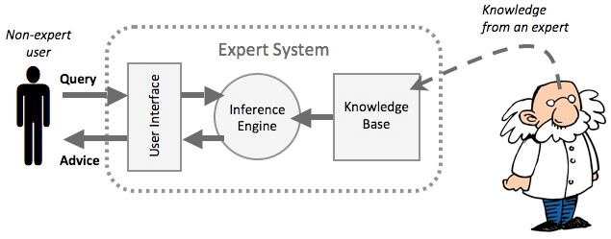
Proliferation of Expert Systems
1980s
Credits: https://www.igcseict.info/theory/7_2/expert/

Slide 15
The second AI Winter
1990s

Slide 16
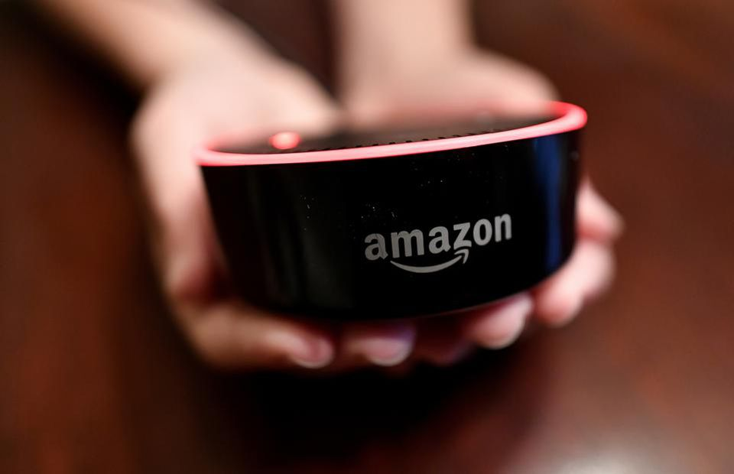
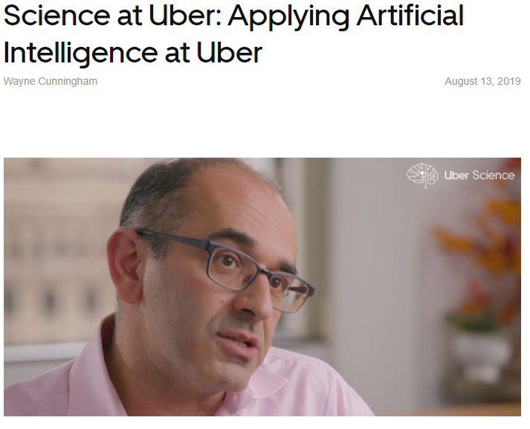
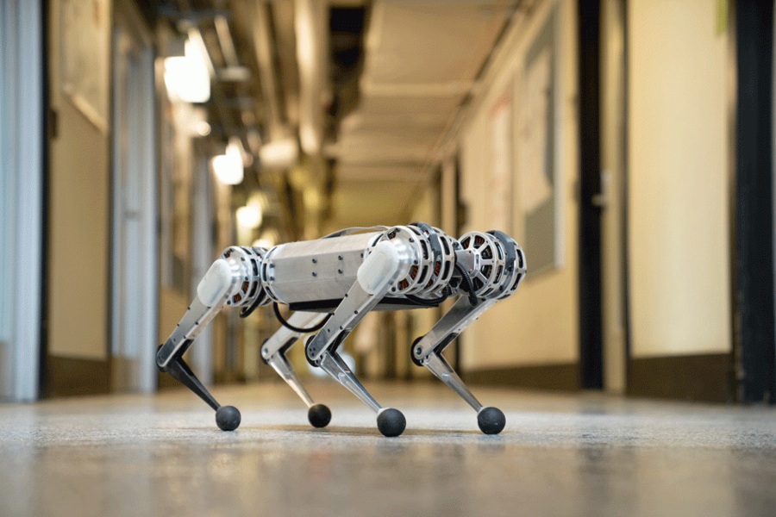
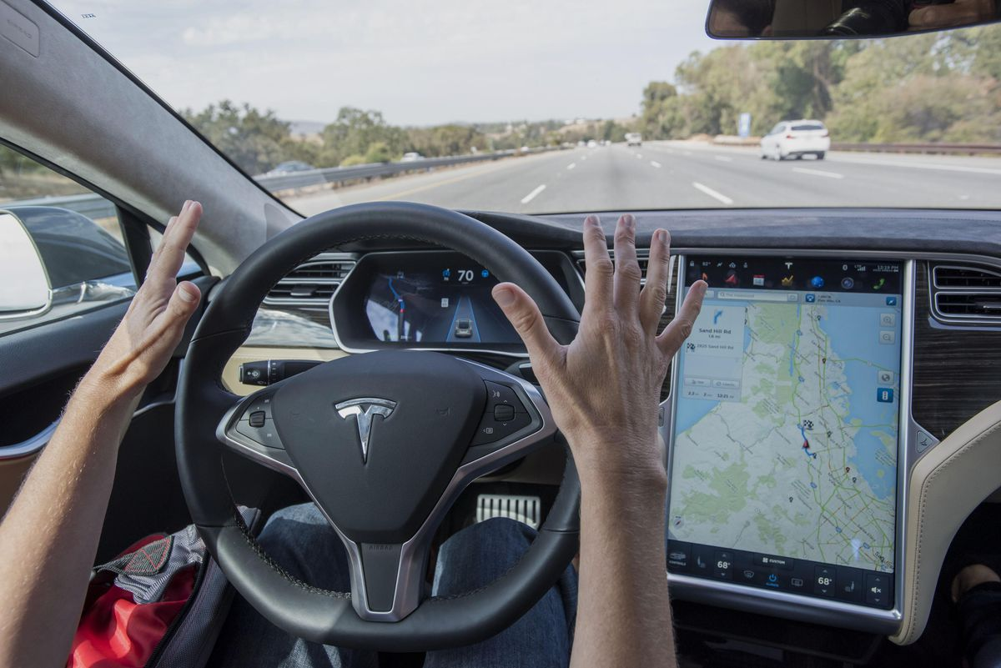
AI Spring
Computer Vision
Natural Language Processing
Speech Recognition
Robotics
Data Science
2000s-now
Notes:
https://news.mit.edu/2019/mit-mini-cheetah-first-four-legged-robot-to-backflip-0304

Slide 17
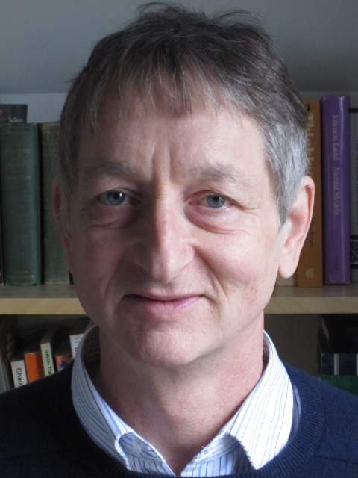
AI Spring
Big Data (e.g, MNIST ~ 70k; ImageNet ~ 10⁶)
Big Compute (GPUs, cloud computing)
“What was wrong in the 80’s is that we didn’t have enough data and we didn’t have enough computer power”
2000s-now
Geoffrey Hinton
Notes:
https://www.wired.com/story/no-data-is-not-the-new-oil/

Slide 18
The case for AI in Brazil

Slide 19
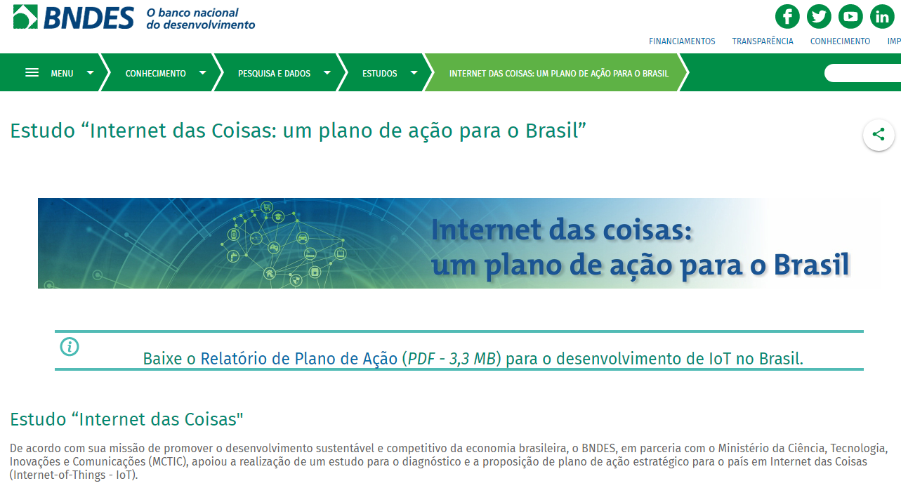
National strategy for IoT
Smart Cities
Healthcare
Agribusiness
Manufacturing
2016

Slide 20
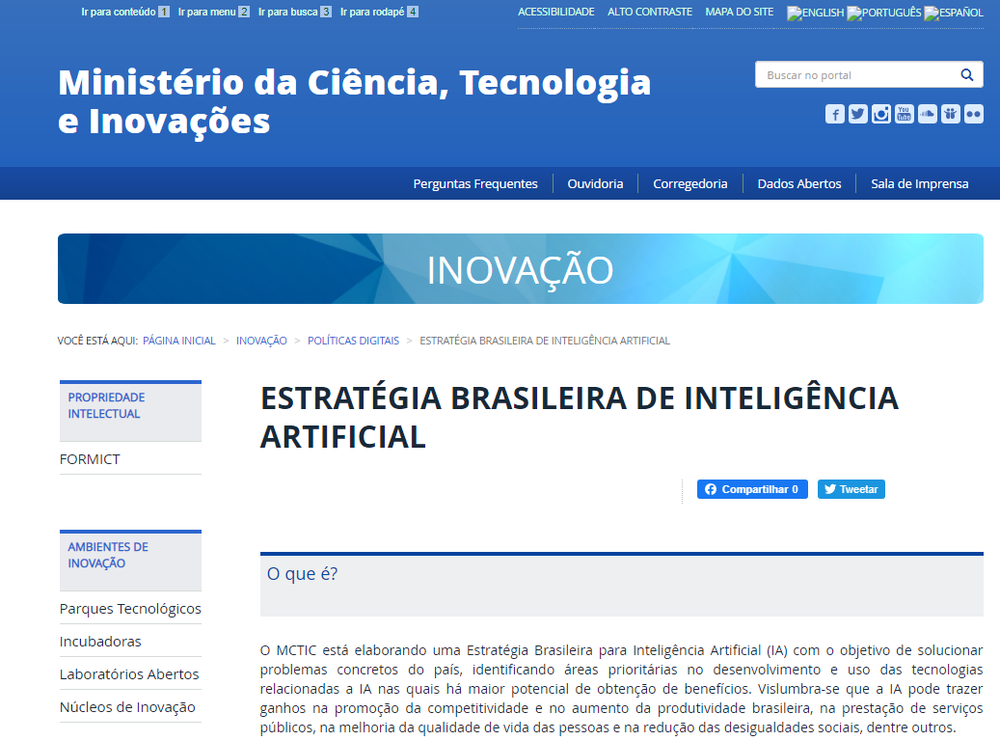
National strategy for AI
2020

Slide 21
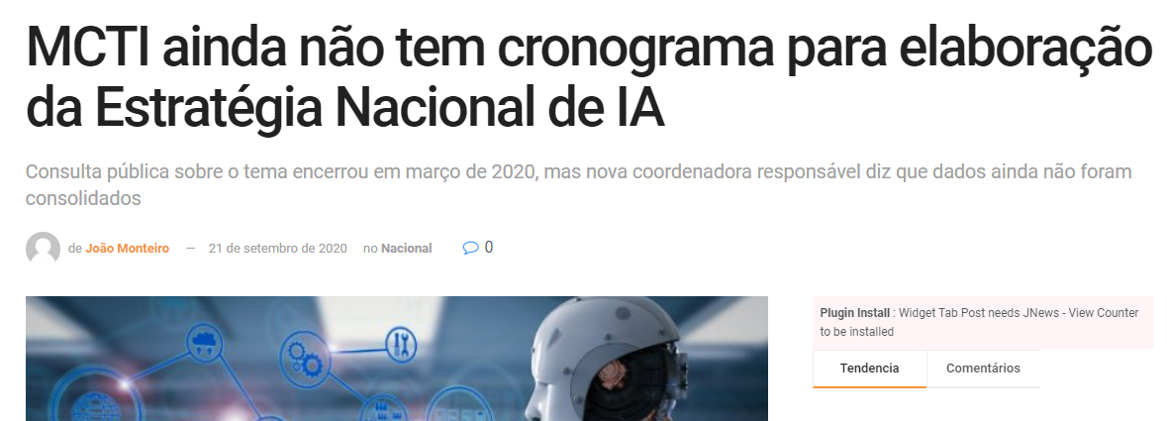
National strategy for AI
2020

Slide 22
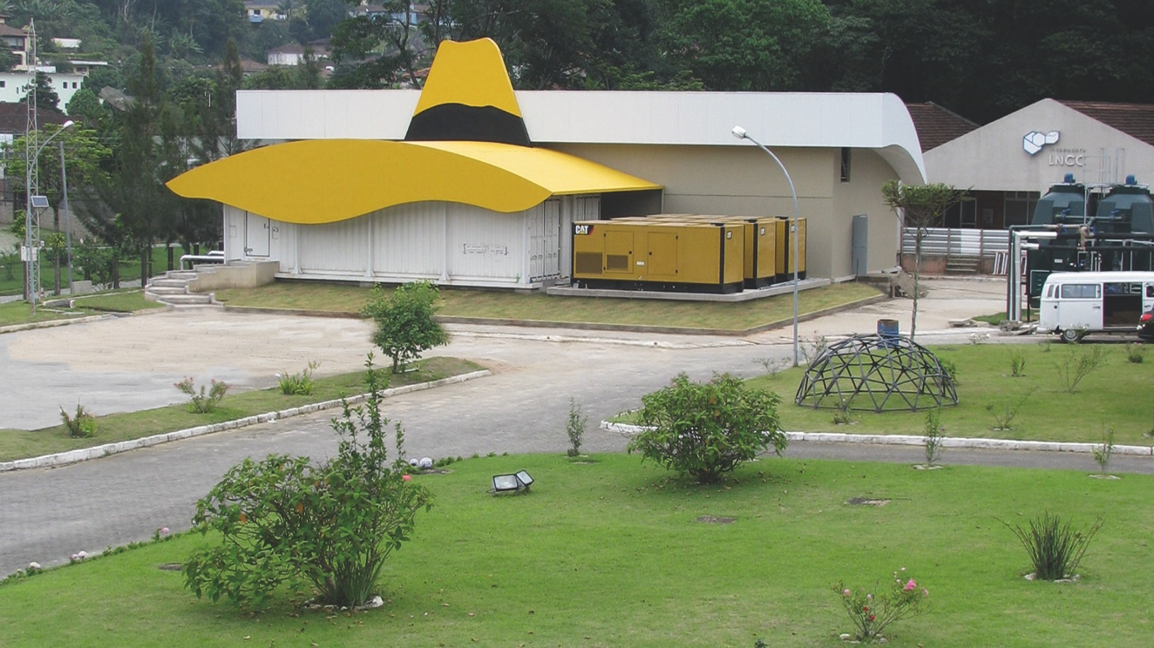
But things are moving…

Slide 23
But things are moving…
https://bigdata.icict.fiocruz.br
Notes:
BASIS - Breastfeeding Information System
https://bigdata.icict.fiocruz.br/basis-breastfeeding-information-system

Slide 24
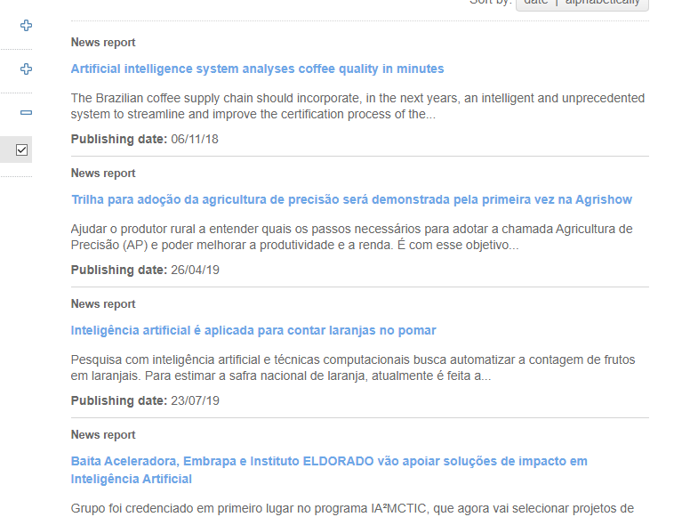
But things are moving…
https://www.embrapa.br/en/busca-geral/-/busca/tag/inteligencia-artificial

Slide 25
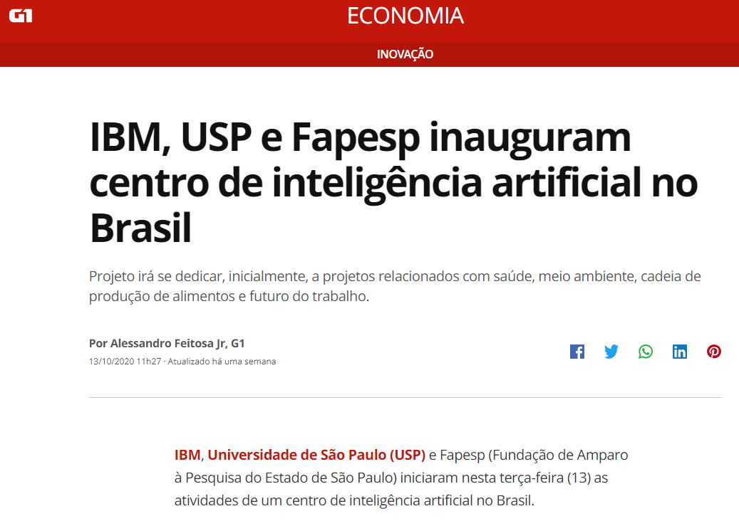
But things are moving…
Notes:
https://g1.globo.com/economia/tecnologia/inovacao/noticia/2020/10/13/ibm-usp-e-fapesp-inauguram-centro-de-inteligencia-artificial-no-brasil.ghtml

Slide 26
Inteligência artificial: a nova fronteira da ciência brasileira
Eduardo Bezerra
ebezerra@cefet-rj.br

