Slide 1
Introduction to Machine learning
Prof. Eduardo Bezerra
(CEFET/RJ)
ebezerra@cefet-rj.br

Slide 2
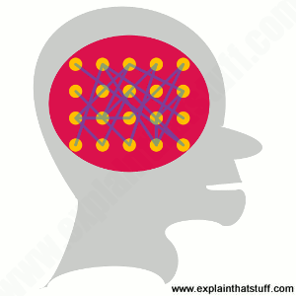
Artificial neural networks

Slide 3
Conteúdo
Representation
Evaluation
Optimization (learning)

Slide 4
Representation

Slide 5
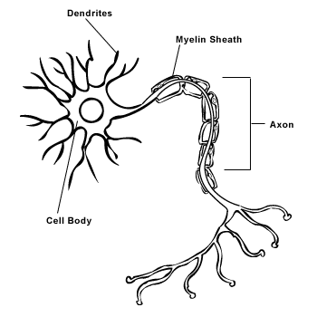
Model of a biological neuron
http://creationwiki.org/Neuron

Slide 6
Artificial Neuron
The artificial neuron is a model inspired by the real
In an artificial neuron:
input are features
each feature has an associated weight
weighted sum of features is called neuron pre-activation
value produced in pre-activation goes through a non-linearity to produce neuron activation

Slide 7
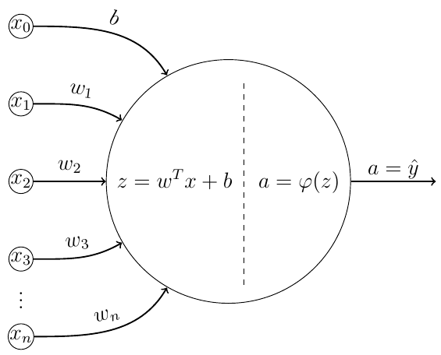
Artificial Neuron
The artificial neuron is a model inspired by the real one (biological neuron).

Slide 8
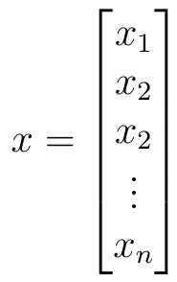
Artificial Neuron - input
features

Slide 9
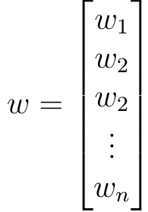
Artificial Neuron – weights
weights
(aka parameters)

Slide 10
Artificial Neuron – pre-activation
pre-activation

Slide 11
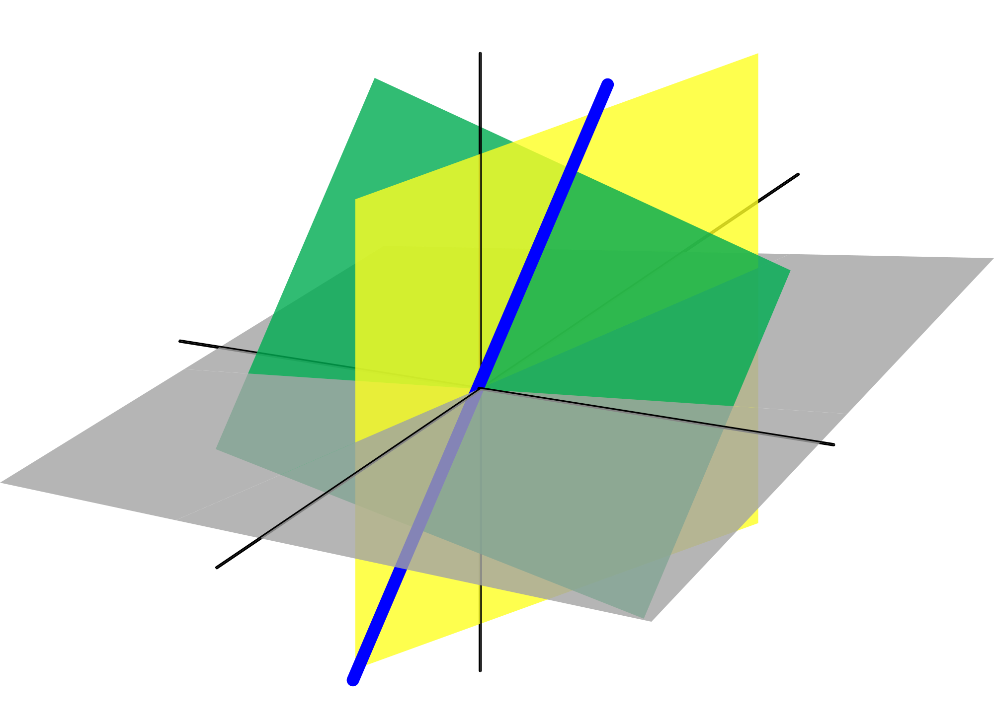
Artificial Neuron – activation function
activation
Nonlinearities are required so that the network can learn complex representations of the data.
"The composition of linear transformations is also a linear transformation"
11
Notes:
activation function

Slide 12
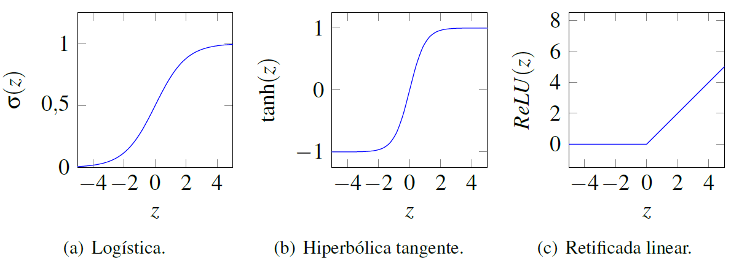
Artificial Neuron – activation functions

Slide 13
Artificial Neuron – activation functions
Sigmoid Logistic
Tangent Hyperbolic
ReLU
softmax

Slide 14
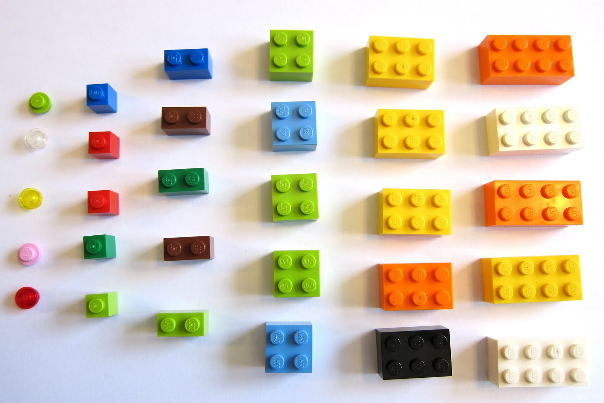
Artificial Neural Net
It is possible to architect arbitrarily complex networks using the artificial neuron as the basic component.

Slide 15
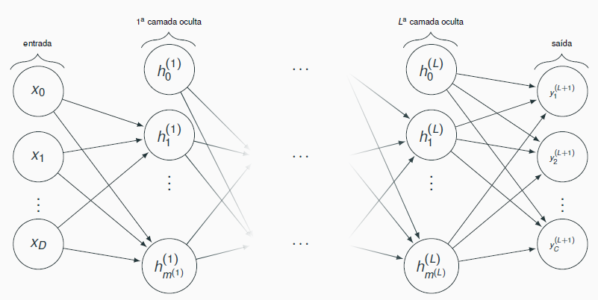
Artificial Neural Net
Feedforward Neural Network

Slide 16
Kinds of layers
In an ANN:
input layer are the input patterns (features);
output layer is result of the computation performed;
other layers are called hidden layers.
Amount of layers and amount of units (neurons) per layer are part of the ANN architecture.

Slide 17
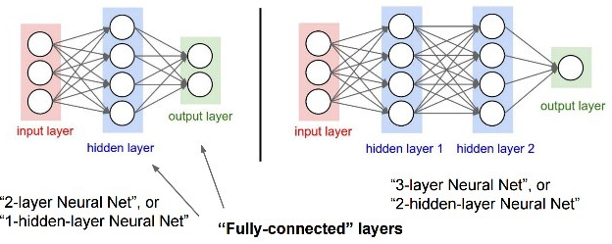
Kinds of layers - example

Slide 18
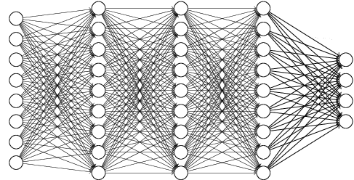
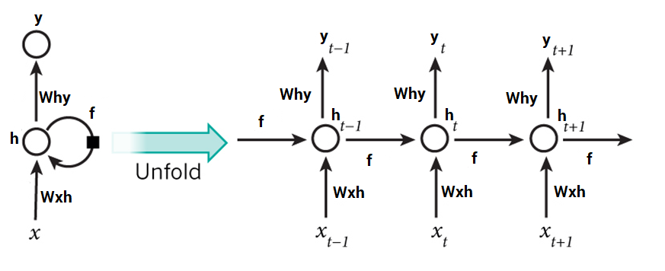
Kinds of ANNs
Fully connected x not fully connected
Recurrent x feed forward

Slide 19
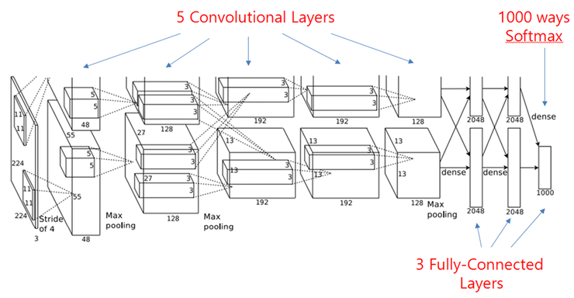
Example: AlexNet (2012)
8 layers

Slide 20
Example: GoogleNet (2014)
22 layers

Slide 21
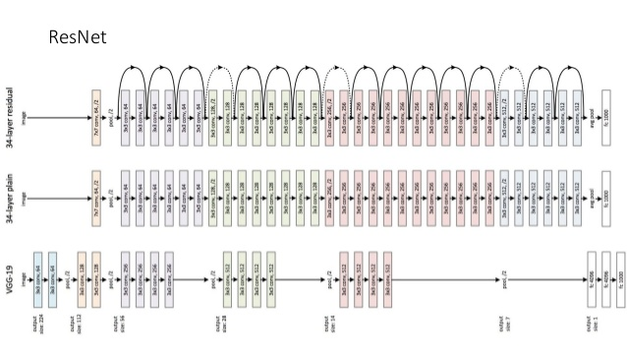
Example: ResNet (2015)
152 layers

Slide 22
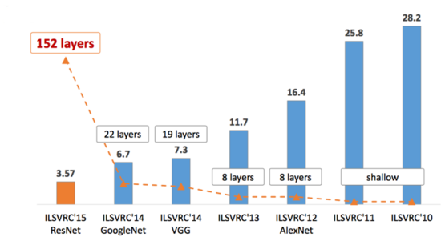
Deep ANNs

Slide 23
ANNs - notation
Pre-activation:
Activation:

Slide 24
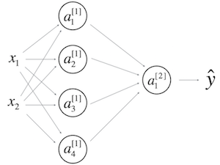
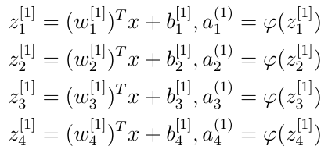
ANNs – notation - example
e.g., in a two-layer ANN:
Computations in the first layer:

Slide 25
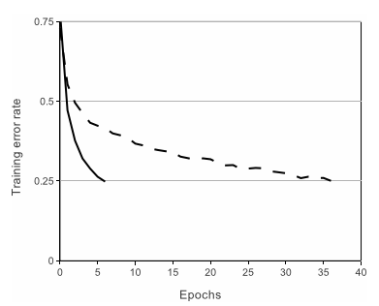
Rectified linear units, ReLU
Convnet of 4 layers with ReLUs.
CIFAR-10 (60K, 32x32 imgs)
It reaches the same error level 6 times faster than tanh.
ImageNet Classification with Deep Convolutional Neural Networks, 2012.
Notes:
Figure 1: A four-layer convolutional neural network with ReLUs (solid line) reaches a 25% training error rate on CIFAR-10 six times faster than an equivalent network with tanh neurons (dashed line). The learning rates for each net- work were chosen independently to make train- ing as fast as possible. No regularization of any kind was employed. The magnitude of the effect demonstrated here varies with network architecture, but networks with ReLUs consis- tently learn several times faster than equivalents with saturating neurons.
The CIFAR-10 dataset consists of 60000 32x32 colour images in 10 classes, with 6000 images per class. There are 50000 training images and 10000 test images.

Slide 26
Evaluation

Slide 27
Cost function
The error signal is the difference between y^{(i)} and output produced for x^{(i)} measures the difference between the network predictions and the desired values.
A cost function must provide a way to measure the error signal for a set o training examples.

Slide 28
Cost function J(W,b)
Cost function: error committed by the network considering all the examples.
function of the set of all weights and bias of the network.
Notes:
A segunda parcela: soma dos quadrados de todos os pesos da RNA. Nessa parcela, o parâmetro $\lambda$, outro hiperparâmetro da RNA, controla a importância relativa entre as duas parcelas da função $\mathbf{J}(\theta)$. Visto que o propósito da otimização é minimizar $\mathbf{J}(\theta)$, podemos concluir que combinações de valores grandes para os pesos não são desejadas, ao menos que eles façam com que o valor da primeira parcela seja muito pequeno. A intuição aqui é que se o vetor de pesos ficar muito grande, um método de otimização que aplica pequenas alterações gradativas a esse vetor não terá condições de alterá-lo significativamente, resultando na convergência para uma solução inadequada. Além disso, incentivar o processo de otimização a manter os pesos pequenos resulta em um RNA menos suscetível a peculiaridades nos dados de entrada.
Quando \textbf{$\theta$} tem muitas componentes ou o conjunto de treinamento não é suficientemente grande, o algoritmo de treinamento é capaz de memorizar todos os exemplos de conjunto, sem produzir um modelo com boa capacidade de generalização.
Esse fenômeno é conhecido como \emph{sobreajuste} (overfitting).
A segunda parcela é apenas uma forma, de diversas possíveis que podem ser usadas com o propósito de evitar que o processo de otimização fique preso em uma solução sub-ótima.

Slide 29
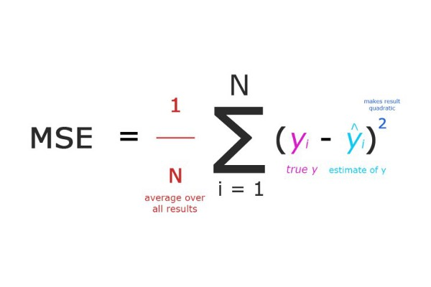
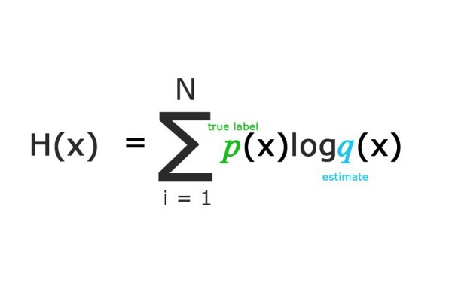
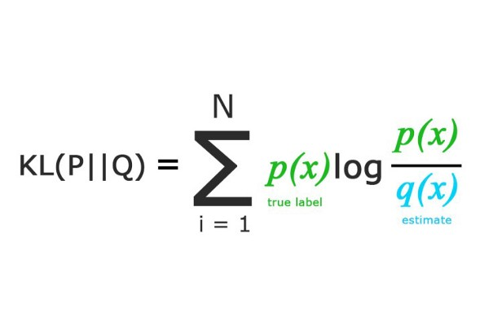
Some cost functions
Source - https://medium.com/machine-learning-for-li/a-walk-through-of-cost-functions-4767dff78f7

Slide 30
Optimization (learning, training)

Slide 31
Training
Given a training set of the form
training an ANN corresponds to using this set to adjust the parameters of the network, so that the training error is minimized.
So, training of an ANN is an optimization problem.
Notes:
$\textbf{x}^{(i)}$ é o vetor de características está associado ao componente $\textbf{y}^{(i)}$.
cujo objetivo é minimizar o erro cometido pela rede, quando considerados todos os exemplos de treinamento.

Slide 32
Training
The error signal (computed with a cost function) is used during training to gradually change the weights (parameters), so that the predictions are more accurate.
Propagation of the example through layers from input to output (→)
Pick a training example
Propagation of the error signal through the layers from the output to the input (←)
Update parameters
W, b.

Slide 33
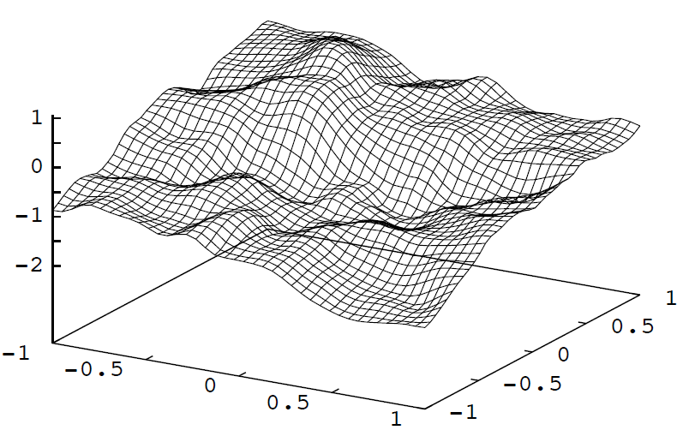
Stochastic Gradient Descent (SGD)
SGD allows to traverse the space of parameters of a neural network in search for a local minimum.
Source: David McKay, ITPRNN
Notes:
Gradient Descent finds the (local) the minimum of the cost function (used to calculate the output error) and is used to adjust the weights.
(figura da direita)
This is from a two-layer feedforward network, two input units, one output unit, very large number of hidden unit. Weights are
chosen randomly from a Gaussian distribution, to get an idea of functions than an ANN “likes” to represent. Source: David McKay, ITPRNN
%http://yyue.blogspot.com.br/2015/01/a-brief-overview-of-deep-learning.html
%Fun story: researchers believed, for many years, that SGD cannot train deep neural networks from random initializations. Every time they would try it, it wouldn’t work. Embarrassingly, they did not succeed because they used the “small random weights” for the initialization, which works great for shallow nets but simply doesn’t work for deep nets at all. When the nets are deep, the many weight matrices all multiply each other, so the effect of a suboptimal scale is amplified.

Slide 34
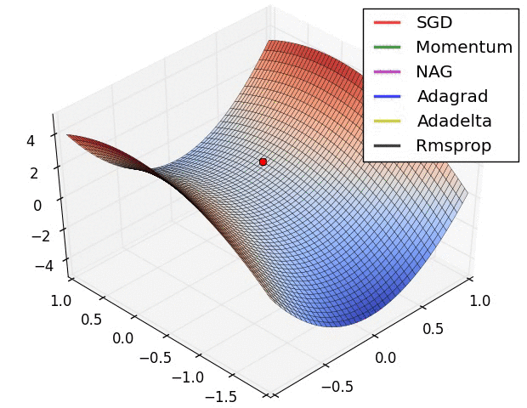
Alternatives to SGD
Source: http://sebastianruder.com/optimizing-gradient-descent/
Notes:
Área de pesquisa ativa: novos métodos de otimização

Slide 35
Backpropagation

Slide 36
Error back-propagation
Consider that the output produced for x^{(i)} is different from y^{(i)} (i.e., there is an nonzero error signal).
Credit Assignment Problem
Then it is necessary to determine the responsibility of each parameter (weight) of the network by this error...
... and change these parameters for the purpose of reducing the error.

Slide 37
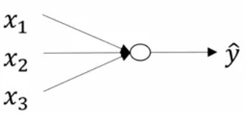
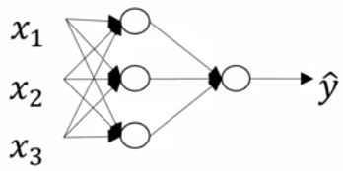
Error back-propagation
In an ANN with at least one hidden layer, there is no direct supervision signal for these layers.
Logistic regression

Slide 38
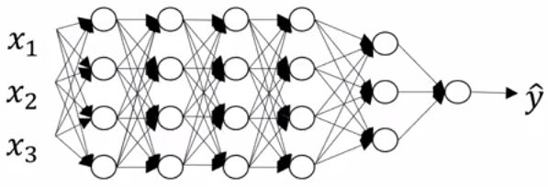
Error back-propagation
This problem gets worse as the amount of hidden layers increases.

Slide 39
Backpropagation
Algorithm invented many times...
Recursively propagates the error signal from the output layer through the hidden layers, to the input layer.
Used in conjunction with some optimization algorithm (e.g., SGD) to gradually minimize network error.
Humelhart et al. Learning representations by back-propagating errors, 1986.
Notes:
Redescoberto muitas vezes: 60’s, 1970, 1982 (Werbos), 1986 (Humelhart, Williams & Hinton)
backprop : para cada um dos pesos, o algoritmo decide se deve AUMENTAR ou DIMINUIR um pouco, de tal forma que, para o lote de exemplos usados, a resposta melhora.
calcular a derivada de g_i com relação a um parâtmetro específico da RNA, por exemplo \theta_k

Slide 40
Backpropagation
Backpropagation, an abbreviation for “backward propagation of errors”, is a common method of training artificial neural networks used in conjunction with an optimization method such as gradient descent. The method calculates the gradient of a loss function with respect to all the weights in the network. The gradient is fed to the optimization method which in turn uses it to update the weights, in an attempt to minimize the loss function.
--Frederik Kratzert
Notes:
https://kratzert.github.io/2016/02/12/understanding-the-gradient-flow-through-the-batch-normalization-layer.html

Slide 41
ANN training with Backpropagation
Set initial weights for the network
Present an example and get the result
For each layer (from the last):
Calculate the error for each neuron
Update the weights (with SGD or variant)
Propagate this error to the previous layer
Repeat with other examples until convergence

Slide 42
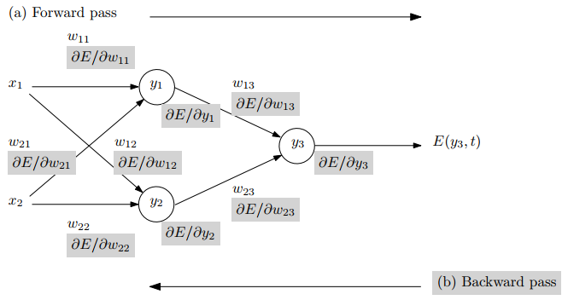
Backpropagation – example
Fonte: Automatic Differentiation in Machine Learning: a Survey (https://arxiv.org/pdf/1502.05767.pdf)

Slide 43
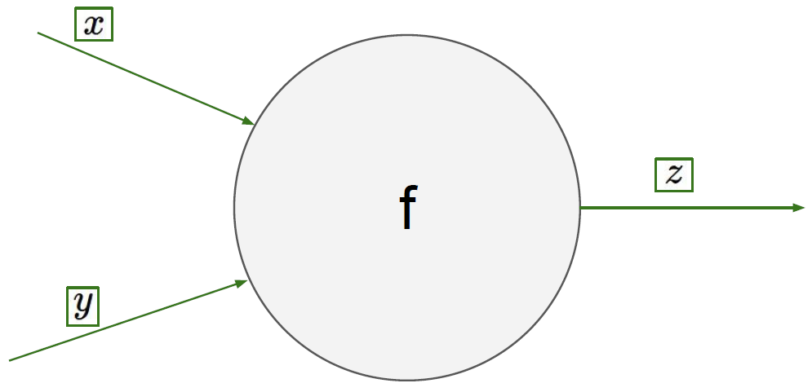
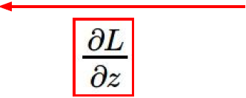
Backpropagation
Fonte: CS231n

