Slide 1

Introduction to
Machine learning
Prof. Eduardo Bezerra
(CEFET/RJ)
ebezerra@cefet-rj.br

Slide 2
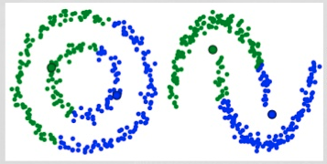
clustering

Slide 3
Overview
Introduction
K-means
Other clustering techniques

Slide 4
Introduction

Slide 5
Clustering
Consists of grouping objects into subsets with the goal of finding trends or patterns in the data.
  e.g., which objects in the collection are similar to each other?
It is an unsupervised learning task.
  There are no labeled examples as well as classification.

Slide 6
General procedure
Input:
  Collection of unlabeled objects.
  Similarity measure (e.g., cosine, Euclidean distance, etc.)
Output:
  Multiple groups of objects.
Constraint: maximize intra-group similarity and minimize similarity between groups.

Slide 7
Clustering
Notes:
Dataset (in two dimensions) with a clearly grouped structure.

Slide 8
k-means

Slide 9
K-means
K-Means determines the centroid (or center of gravity or mean) of points of each group c:
Formation of the groups is based on the distance between examples x^{(i)} the centroids s_{j}.
Notes:
K-means is the best known algorithm of the family clustering clustering.
Considers that objects to be grouped are represented as vectors.
It works with the notion of a vector (point) representative of each group to be formed: prototype.
This prototype should be some central point of the group, e.g.,
point belonging to the collection and closer to the center in the group: medoid.
point that is the "average" of all objects in the group: centroid.

Slide 10
K-means - algorithm
Select k initial centroids
Repeat until convergence criteria is met:
  For each x^{(i)}
    Assign x^{(i)} to group c_{j} such that dist(x^{(i)}, s_{j}) is minimum, where s_{j} is the centroid of cluster c_{j}.
  For each c_{j}, update its centroid:
    s_{j} ← μ(c_{j})

Slide 11
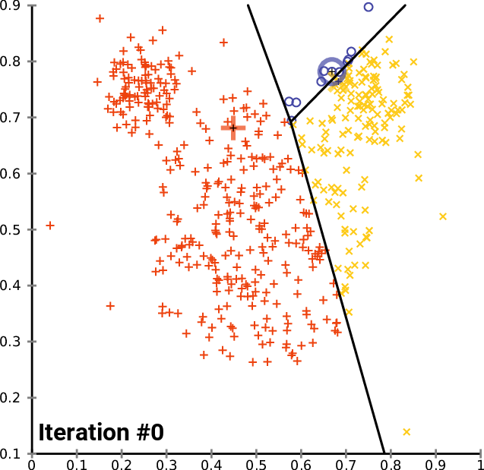
K-means (example for K=2)
Source: https://en.wikipedia.org/wiki/K-means_clustering

Slide 12
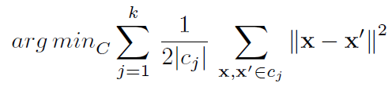
K-means – objective function
K-means solves an optimization problem.
One measure of how well the centroids represent their respective groups is the residual sum of squares (RSS).
Notes:
C = {c₁, c₂, …, c_{k}}

Slide 13
K-means – implementation aspects
Choice of a value for K
Choice of seeds
Choice of convergence criterion

Slide 14
Limitations of k-means
k-means works properly when groups:
  are spherical
  are far apart
  have similar volumes
  have similar amounts of points

Slide 15
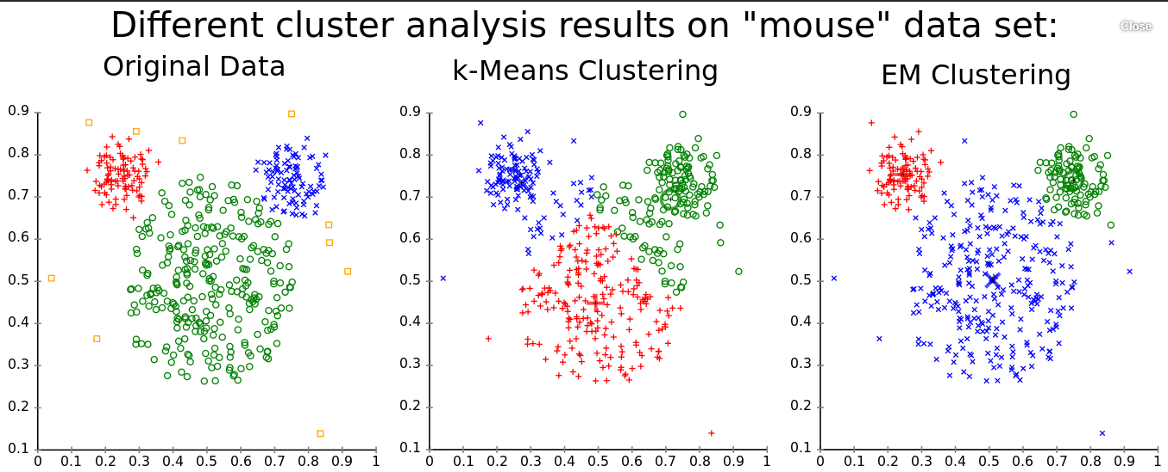
Limitations of k-means
Source: https://en.wikipedia.org/wiki/K-means_clustering

Slide 16
Other clustering techniques

Slide 17
Other clustering techniques
K-medoids
Gaussian mixtures (EM)
DBSCAN
OPTICS
Hierarchical clustering algoritms
Notes:
“A medoid can be defined as the object of a cluster whose average dissimilarity to all the objects in the cluster is minimal. i.e. it is a most centrally located point in the cluster.”
https://en.wikipedia.org/wiki/K-medoids

