Slide 1
Introduction to Machine learning
Prof. Eduardo Bezerra
(CEFET/RJ)
ebezerra@cefet-rj.br

Slide 2
Model Evaluation and Selection

Slide 3
Visão Geral
Model Evaluation
Model Selection

Slide 4
Model Evaluation

Slide 5
Generalization error
Error we would get if we could evaluate the model over the entire population.
Just because a hypothesis fits the training set well does not mean that it is a good hypothesis.
The training error (empirical error) most likely will be less than the generalization error.
Notes:
Generalization error (out-of-sample error) is the error we would get if we could evaluate the model over the entire population (i.e., over all the underlying joint distribution).

Slide 6
Model Evaluation
A hypothesis may present a low training error, but still be poor (due to overfitting)
Therefore, it is appropriate to evaluate the performance of an algorithm on unseen data.
Model Evaluation refers to the process of estimating the generalization error of a ML model.

Slide 7
Evaluation metrics
Accuracy, precision
Precision, recall, F1 measure
Squared errors
Likelihood
Posterior probability
Cost/utility
Margin
KL divergence
....

Slide 8
Evaluation techniques
Common techniques for estimating the generalization performance of a ML model:
holdout method
k-fold cross-validation

Slide 9
Holdout method (training/test)
Randomly split original dataset into separate training and test datasets:
training dataset: used for training a model M
test dataset: used to estimate the generalization error of M
Can lead to a misleading estimate of the generalization error if the test data is also used for model selection.

Slide 10
Holdout method (training/validation/test)
A better way: separate the data into three parts.
training set: used to fit several models
validation set: performance on this set if used for model selection.
test set: used only to estimate the generalization error.
Typical proportions are 70%/15%/15% and 60%/20%/20% .

Slide 11
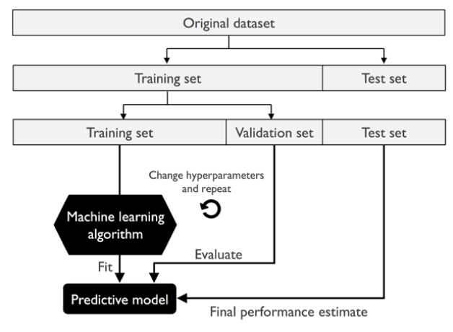
Holdout method (training/validation/test)
Source: Python Machine Lerning, 2nd ed., pp 191

Slide 12
k-fold cross-validation
Randomly split the training dataset into k folds without replacement
k-1 folds are used for the model training
one fold is used for performance evaluation.
Procedure is repeated k times so that we obtain k models and performance estimates.
Notes:
A Study of Cross-Validation and Bootstrap for Accuracy Estimation and Model Selection, Kohavi, Ron, IIJCAI, 14 (12): 1137-43, 1995

Slide 13
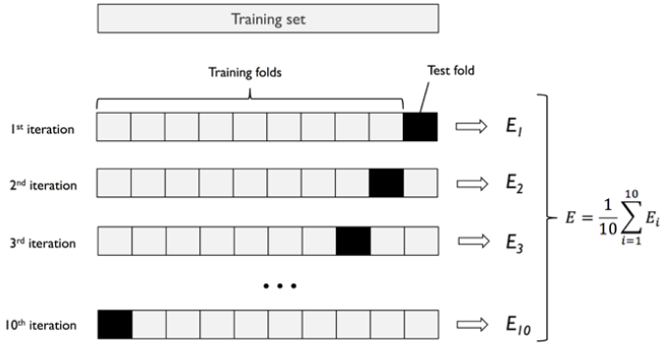
k-fold cross-validation
Source: Python Machine Lerning, 2nd ed., pp 191

Slide 14
k-fold cross-validation
Keep in mind that, as k increases:
Bias in the estimation of the generalization error decreases;
Computational cost also increases.
Empirical evidence shows that k=10 is a good value for datasets of moderate size.
For large sized datasets, k can be safely decreased.

Slide 15
Other techniques
Leave-one-out cross-validation
Stratified k-fold cross-validation
Bootstrap validation
Improvements on Cross-validation: The .632+ Bootstrap Method, B. Efron and R. Tibshirani, Journal of the American Statistical Association, 92(438): 548-560, 1997
A Study of Cross-Validation and Bootstrap for Accuracy Estimation and Model Selection, International Joint Conference on Artificial Intelligence (IJCAI), 14 (12): 1137-43, 1995

Slide 16
Notation
: training set size
: training data set
: test set size
: test dataset
: error calculated in test set (test error)

Slide 17
Model Selection

Slide 18
Model Selection
Hyperparameters are parameters that are not directly learnt within models.
Model selection is the process of selecting the optimal hyperparameters values for a ML algorithm.
Examples:
degree of the polynomial in polynomial regression;
regularization term; learning rate;
many more…

Slide 19
Model Selection - example
Given many models, we apply a systematic approach to identify the "best" model.
The “best” model is chosen by using some quality measure (e.g., MSE in linear regression).
Let us see an example in the context of polynomials with different degrees…

Slide 20
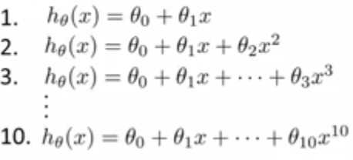
Model Selection - example (cont.)
Suppose we want to choose the right degree to fit a polynomial regression.
Notes:
Suppose we want to choose (from a set of 10 possible options) the right degree to fit a polynomial regression.

Slide 21
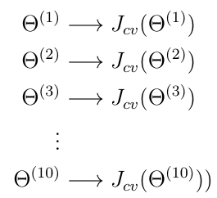
Model Selection - example (cont.)
To choose one of these models, we select the one with the least validation error.
Notes:
Suppose we want to choose (from a set of 10 possible options) the right degree to fit a polynomial regression.

Slide 22
Model Selection - example (cont.)
Finally, we calculated the test error on the polynomial that produced the smallest validation error.

Slide 23
Model selection - general procedure
Optimize the hyperparameters in Θ using the training set for each degree of polynomial.
Find Θ*, the setting of hyperparameters with the smallest error in the validation set.
Estimate the generalization by computing error of the final model in the test set.

Slide 24
Hyperparameter search
How to do search?
There are two main approaches to search in the space of hyperparameters:
Grid search exhaustively considers all hyperparameter combinations, for a set of given values.
Randomized search can sample a given number of candidates from a hyperparameter space with a specified distribution.

Slide 25
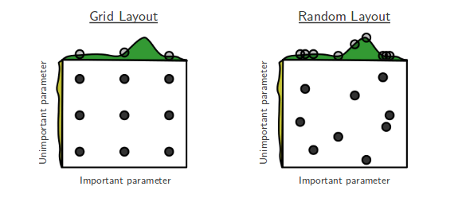
Hyperparameter search

