Slide 1
Introduction to Machine learning
Prof. Eduardo Bezerra
(CEFET/RJ)
ebezerra@cefet-rj.br

Slide 2
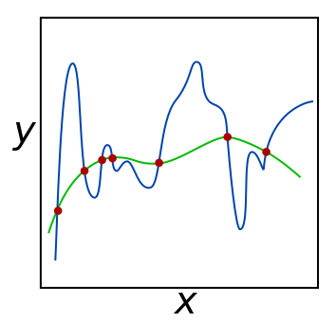
Model Regularization
Notes:
Créditos da figura: https://en.wikipedia.org/wiki/Regularization_(mathematics)

Slide 3
Overview
Preliminary concepts
Regularization
Regulated linear regression
Regulated logistic regression

Slide 4
Preliminary concepts

Slide 5
Generalization
In predictive ML, the goal is to induce models that perform well in general, not just in the training set.
We say that a model has a good generalization if it is able to make adequate predictions about data not used during training.

Slide 6
Goodness of fit
In ML, a hypothesis function is said to fit the training data.
The hypothesis seeks to approximate the (unknown) target function.
An important aspect to measure is the quality of this approximation.

Slide 7
Goodness of fit
A ML algorithm should exercise temperance in order to achieve goodness of fit.
extremo
meio-termo
extremo
Notes:
Fonte da figura: https://shapeofdata.wordpress.com/2013/03/26/general-regression-and-over-fitting/
Significado de temperança: https://www.dicio.com.br/temperanca/

Slide 8
Model complexity
In AM, the complexity of a learning model relates to the amount of free parameters that it uses.
A model too complex is formed by so many parameters that the model "memorizes" all training data.
A model too simple is formed by an insufficient number of parameters that do not allow it to capture the underlying trends in the data.
Notes:
Em AM, a complexidade de um modelo de aprendizado diz respeito à quantidade de parâmetros livres que ele utilizada.
Entretanto, podem ser definidas restrições sobre os parâmetros, o que diminui a complexidade do modelo (mais sobre isso adiante).
Um modelo muito complexo quando é formado por tantos parâmetros que o modelo “memoriza” todos os dados de treinamento, não apenas os sinais, mas também o ruído aleatório, os erros e todas as características específicas da amostra.
Um modelo muito simples é formado por uma quantidade insuficiente de parâmetros que não permitem que ele apreenda a tendência subjacente nos dados.

Slide 9
Bias and variance of a ML model
Assume that we could retrain a model multiple times on different training datasets (samples).
Variance measures the consistency (or variability) of the model prediction for a particular sample instance.
Bias measures how far off the predictions are from the correct values.
Notes:
Bias is the measure of the systematic error that is not due to randomness
https://stats.stackexchange.com/questions/256141/mathematical-intuition-of-bias-variance-equation?noredirect=1&lq=1

Slide 10
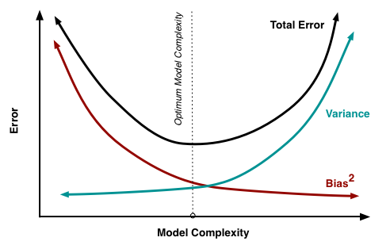
bias-variance tradeoff
Increasing the bias will decrease the variance. Increasing the variance will decrease the bias.
Notes:
Source: http://scott.fortmann-roe.com/docs/BiasVariance.html
See also: https://stats.stackexchange.com/questions/336433/bias-variance-tradeoff-math
“bias-variance tradeoff is in the context of a fixed sample size, and what we vary is the model complexity, e.g., by adding predictors.”

Slide 11
Overfitting and underfitting
The inadequate complexity (of an inductive model) can lead to one of two phenomena, both unwanted:
Overfitting
Underfitting

Slide 12
Underfitting
Occurs when a ML model cannot capture the underlying trend of the data.
An underfitted model shows low variance and high bias.
Often a result of an excessively simple model.
Rarely seen in practice.
Notes:
Intuitively, underfitting occurs when the model or the algorithm does not fit the data well enough

Slide 13
Overfitting
Occurs when a ML model adapts to the training data, but does not generalize to new data.
Usually caused by a complicated model that creates many unnecessary curves and unrelated angles to the population from which the training data came from.
Often seen in practice!

Slide 14
Overfitting vs underfitting - example
Notes:
Exemplo no contexto da regressão polinomial

Slide 15
Solutions to overfitting
Reduce the number of features
Manually select which features to maintain.
Use a dimensionality reduction algorithm.
Regularization
Maintain all the features, but reduce the magnitude of the parameters.
Regularization works well when we have many useful features.

Slide 16
Regularization

Slide 17
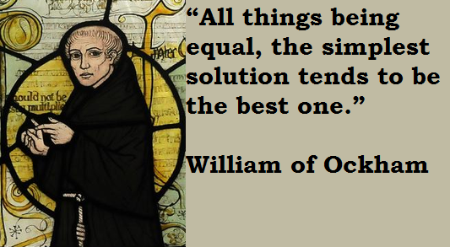
Regularization
Technique that penalizes complex explanations of the data, even if they are consistent with the training set.
Rationale: such explanations do not generalize well.
They may explain data points from the training set, but this may be only because of the specificities of the sample used for training.
Notes:
A regularização penaliza a complexidade, mesmo que isso signifique escolher uma modelo menos preciso de acordo com os dados de treinamento.

Slide 18
Regularization – basic ideia
General idea: produce parameters with small absolute values during optimization.
Effects:
simpler hypotheses (more smooth, less sinuous functions);
resulting model is less susceptible to overfitting.
Why does it work?!

Slide 19
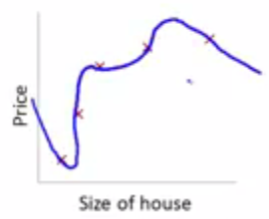
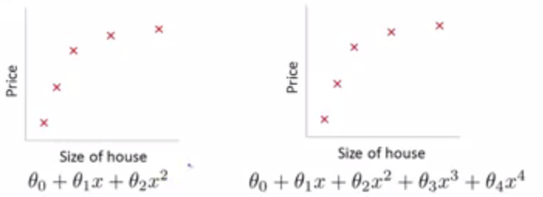
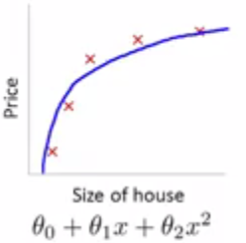
Regularization - intuition (polynomial regression)
Suppose we want to force the model to the right to be more similar to a quadratic form...
Notes:
Intuição sobre a regularização (no contexto da regressão polinomial)

Slide 20
Regularization - intuition (cont.)
To do this, we must reduce the influence of the following terms: e .
This can be done by modifying the cost function and the minimization problem:

Slide 21
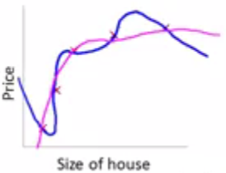
Regularization - intuition (cont.)
Effect: smoothing of the original model.
Notes:
Agora, suponha que (e.g., em um problema de regressão) tenhamos, e.g., 100 características. Neste caso, não temos como visualizar a hipótese para saber que parâmetros penalizar. Entretanto, mesmo assim a ideia de manter os componentes do vetor de parâmetros restritos a valores pequenos ainda é útil.

Slide 22
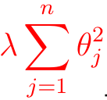
Regularization - general idea
We use the following general expression for the cost function in regularized linear regression:
: regularization parameter
: regularization term
Notes:
Embora apresentada aqui no contexto da função de custo da regressão linear, essa terminologia é usada de forma geral.

Slide 23
Terminology
Tikhonov regularization (Math, inverse problems)
Ridge regression (Statistics)
Weight decay (ML)
L1 regularization
L2 regularization
Ng, Andrew Y. (2004). Feature selection, L1 vs. L2 regularization, and rotational invariance. Proc. ICML.
Notes:
Ng, Andrew Y. (2004). Feature selection, L1 vs. L2 regularization, and rotational invariance. Proc. ICML.
https://icml.cc/Conferences/2004/proceedings/papers/354.pdf
Is Tikhonov regularization the same as Ridge Regression?
https://stats.stackexchange.com/questions/234280/is-tikhonov-regularization-the-same-as-ridge-regression

Slide 24
Value for the regularization parameter
For a successful regularization, it is necessary to appropriately choose the value of
What can happen if it is ...
... too large (e.g., )?
... very small (e.g., )?
must be chosen by using model selection.

Slide 25
Regularized linear regression

Slide 26
Cost function
is the regularization term.

Slide 27
Gradient descent
Without regularization:
With regularization:
is not influenced by regularization

Slide 28
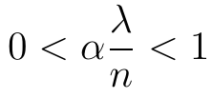
Gradient descent (cont.)
Let us isolate in the expression for its update:
The highlighted term is positive and close to zero:
Thus, we can interpret the first factor as a depreciation applied to
Notes:
Thus, in regularized linear regression, two subsequent transformations occur on the value of \theta in each iteration of the GD:
amortization of the value of;
update on the amortized value (as already happens in non-regularized linear regression).

Slide 29
Why is not regularized?
Overfitting usually occurs in models where the output is sensitive to small changes in the input data.
i.e., model that interpolate exactly the target values
tends to require a lot of curvature in the function being adjusted
does not contribute to the curvature of the model.
so there is no interest in regularizing it.
Notes:
https://stats.stackexchange.com/questions/153605/no-regularisation-term-for-bias-unit-in-neural-network

Slide 30
Regularized logistic regression

Slide 31
Cost function
Unregularized version:
Regularized version:
Notes:
Note que a regularização não é aplicada a \theta_0.

Slide 32
Gradient descent
Notes:
O GD para a regressão logística regularizada é apresentado nesta página.

