Slide 1

Introduction to
Machine learning
Prof. Eduardo Bezerra
(CEFET/RJ)
ebezerra@cefet-rj.br

Slide 2
Linear Regression

Slide 3
Overview
Introduction
Univariate Linear Regression
  Model representation
  Model evaluation
  Model optimization
Multivariate Linear Regression
Practical issues: feature scaling & feature engineering
Polynomial Regression

Slide 4
Introduction

Slide 5
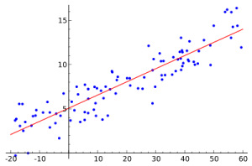
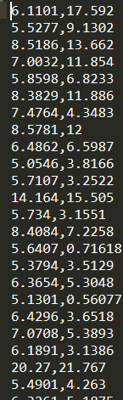
Linear regression problem (2D)

Slide 6
Notation
m = amount of training examples
x = a vector of features
y = target value (scalar)

Slide 7
Components
In order to apply any ML algorithm (including linear regression), we need to define three components:
  Model representation
  Model evaluation
  Model optimization

Slide 8
Model representation

Slide 9
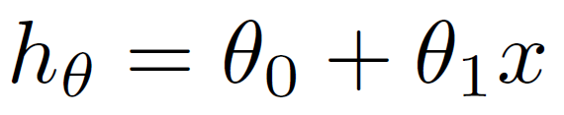
Representation (univariate case)
A hypothesis is a function that maps from x's to y's.
How can a hypothesis be represented in the univariate linear regression setting?

Slide 10
Model Evaluation (with a cost function)

Slide 11
Model parameters
Once...
  we have the training set in hand, and
  we define the form (of representation) of the hypothesis ...
... how do we determine the parameters of the model?
Idea: choose the combination of parameters such that the hypothesis produces values close to the values y contained in the training set.

Slide 12


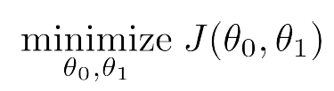
Mean Squared Error (MSE) measure
In linear regression, hypothesis are evaluated through the MSE measure.

Slide 13
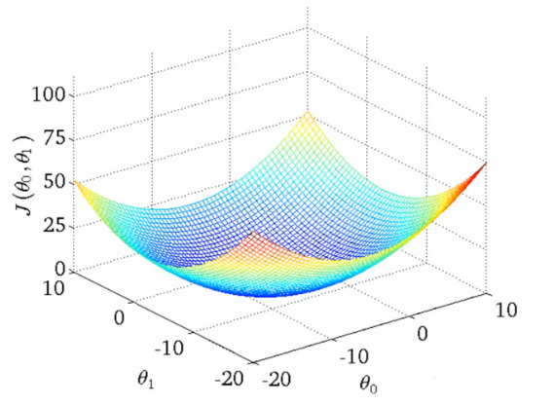
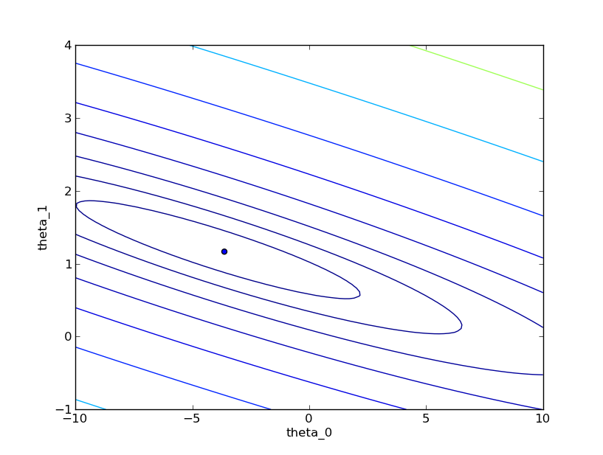
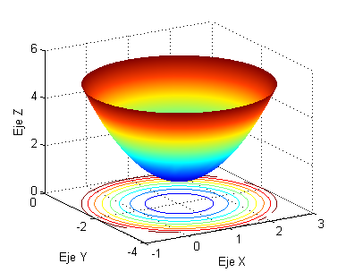


Level curves for J (two parameters)

Slide 14
Model Optimization (parameter learning)

Slide 15

Gradient Descent algorithm
Given a cost function J, we want to determine the combination of parameter values that minimizes J.
Optimization procedure:
  Initialize the parameter vector
  Iterate: update parameter vector with the purpose of finding the minimum value of J

Slide 16
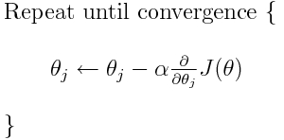
Gradient Descent algorithm
Updating must be simultaneous!
α is a small positive constante, the learning rate (more later)
Notes:
Derivada parcial
Taxa de aprendizado (learning rate)

Slide 17
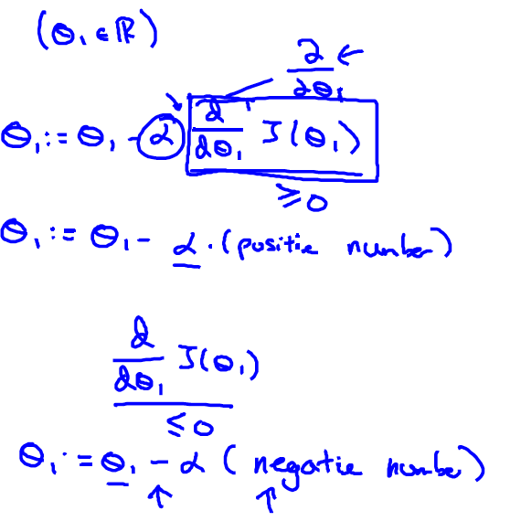

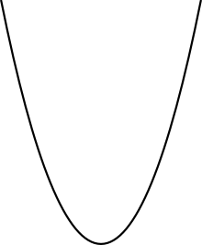
Gradient Descent - intuition
Notes:
Calculamos a derivada no ponto correspondente ao valor atual de theta_1. Esse valor de derivada nos informa se devemos nos mover para a direita ou para a esquerda (isto é, aumentar ou diminuir o valor de theta_1).
se um ponto tem derivada positiva, então devemos nos mover para a esquerda (diminuir o valor de theta_1).
se um ponto tem derivada negativa, então devemos nos mover para a direita (diminuir o valor de theta_1).

Slide 18
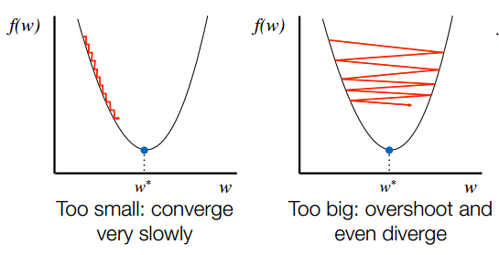
Learning rate
(learning rate): hyperparameter that needs to be carefully chosen...
How? Try multiple values and pick the best one
  model selection (more latter).
Notes:
Digression: AutoML

Slide 19
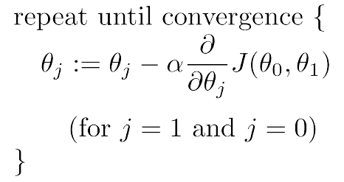
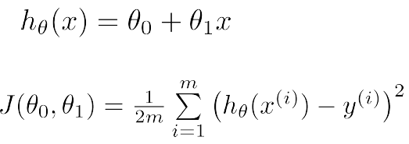
GD for Linear Regression (univariate case)
Gradient Descent
Linear Regression Model
Notes:
Batch Gradient Descent: in each iteration of the algorithm, the entire training set is used.

Slide 20
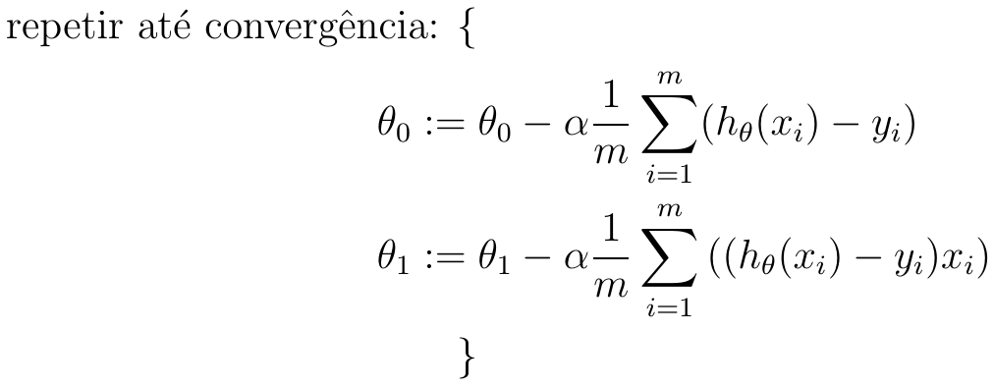
GD for Linear Regression (univariate case)
Notes:
Realizar atualização simultânea

Slide 21
Multivariate Linear Regression

Slide 22
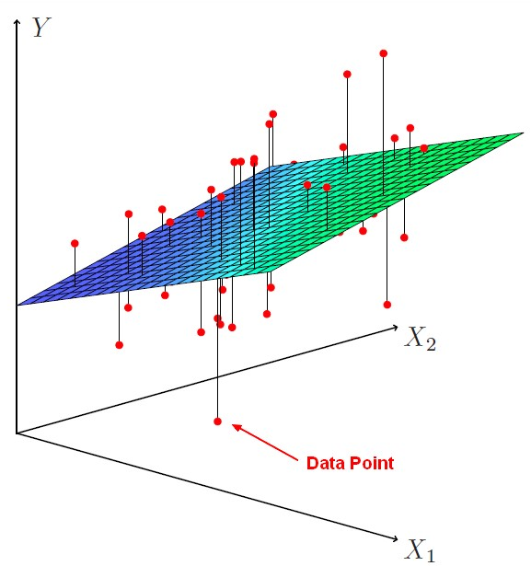
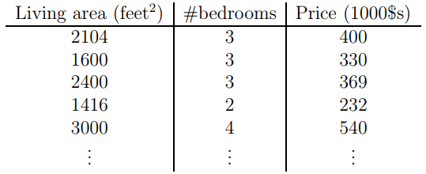
Multiple features (n=2)
Source: https://gerardnico.com

Slide 23
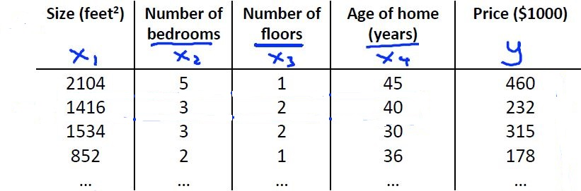
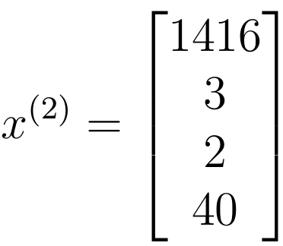
Multiple features (n=4)

Slide 24



Notation
: i-th training example.
: j-th feature value in the i-th example;
: amount of features

Slide 25

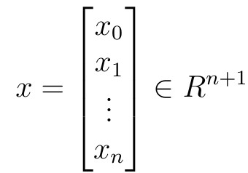
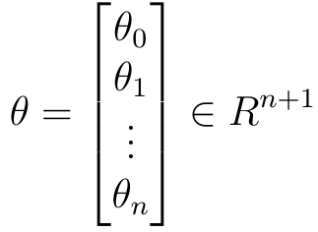


Model representation
Univariate case (n=1):
Multivariate case (n > 1):
Notes:
Podemos reescrever a hipótese da Regressão Linear Multivariada como um produto escalar (scalar product, dot product)
Definir x_0^{(i)} = 1 é a penas uma conveniência de notação, para possilitar definir a hipótese como um produto escalar de dois vetores (n+1)-dimensionais.

Slide 26
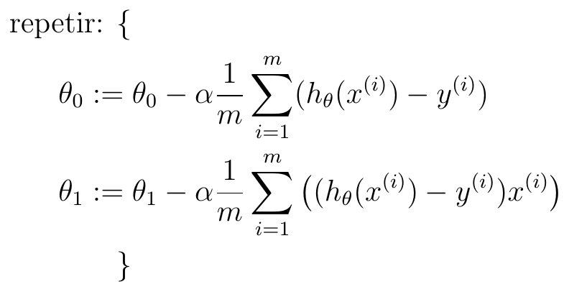
Gradient Descent (n = 1)

Slide 27
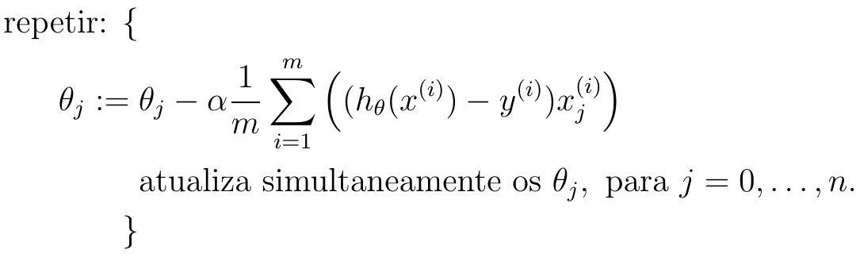
Gradient Descent (n ≥ 1)
Reminder:

Slide 28
Practical issue: feature scaling
Here we study the effect of the existence of different scales on the dependent variables.

Slide 29
Feature scaling
“Since the range of values of raw data varies widely, […], objective functions will not work properly without normalization. […] If one of the features has a broad range of values, the distance will be governed by this particular feature. Therefore, the range of all features should be normalized so that each feature contributes approximately proportionately to the final distance. Another reason why feature scaling is applied is that gradient descent converges much faster with feature scaling than without it.”
--Wikipedia
Scaled features make ML algorithms converge better and faster.
Notes:
https://en.wikipedia.org/wiki/Feature_scaling

Slide 30

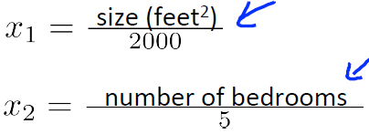
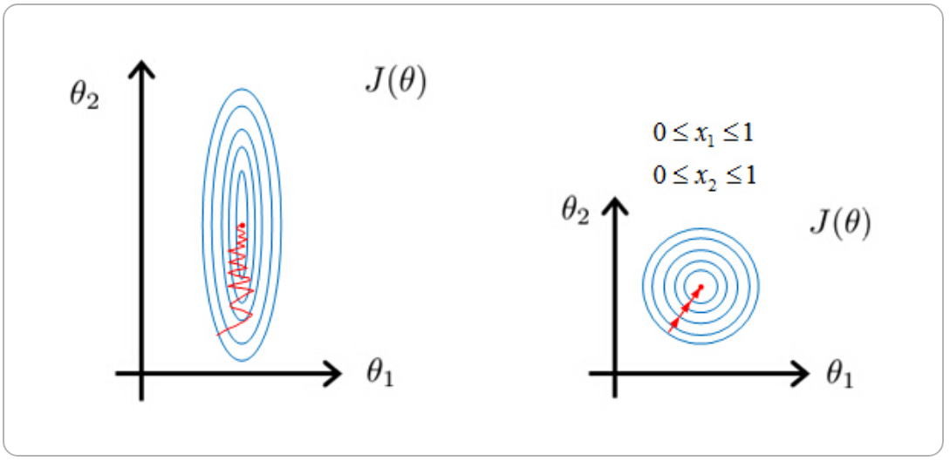
Why feature scaling?
Notes:
https://stackoverflow.com/questions/26225344/why-feature-scaling

Slide 31



Some feature scaling techniques
Min-max scaling
z-score
Scaling to unit length
Notes:
https://en.wikipedia.org/wiki/Feature_scaling

Slide 32
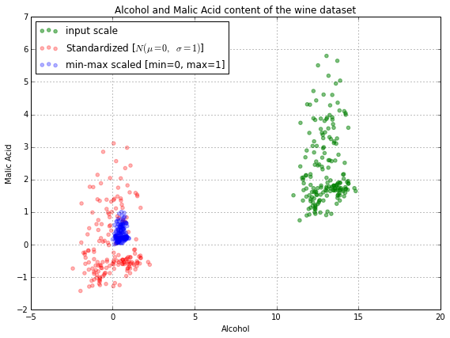
Scaling techniques - example
Source: http://sebastianraschka.com/Articles/2014_about_feature_scaling.html

Slide 33
Practical issue: feature engineering
Here we study techniques to create new features.

Slide 34
Feature engineering
In ML, we are not limited to using only the original features for training a model.
Depending on the knowledge we have of a particular dataset, we can combine the original features to create new ones.
  This can lead to a better predictive model.

Slide 35
Feature engineering
The algorithms we used are very standard for Kagglers. […] We spent most of our efforts in feature engineering. [...] We were also very careful to discard features likely to expose us to the risk of overfitting our model.
— Xavier Conort, "Q&A with Xavier Conort
…some machine learning projects succeed and some fail. What makes the difference? Easily the most important factor is the features used.
— Pedro Domingos, "A Few Useful Things to Know about Machine Learning"
Coming up with features is difficult, time-consuming, requires expert knowledge. "Applied machine learning" is basically feature engineering.
— Andrew Ng, Machine Learning and AI via Brain simulations
Notes:
Quotes taken from https://en.wikipedia.org/wiki/Feature_engineering

Slide 36
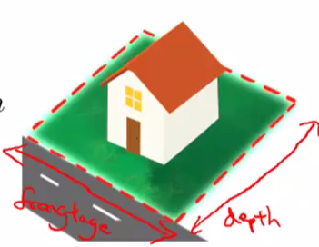


Feature engineering - example

Slide 37
Polynomial regression
Here we study how to get approximations for non-linear functions.

Slide 38
Polynomial regression
A method to find a hypothesis that corresponds to a polynomial (quadratic, cubic, ...).
Related to the idea of features engineering.
It allows to use the linear regression machinery to find hypotheses for more complicated functions.
Notes:
RLM = regressão linear multivariada

Slide 39
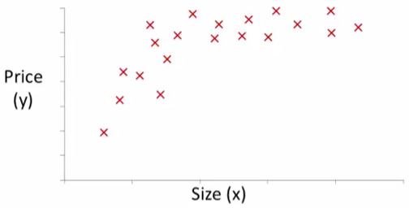


Polynomial regression - example

Slide 40
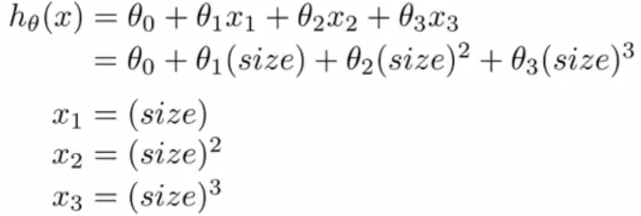
Polynomial regression - example (cont.)

Slide 41
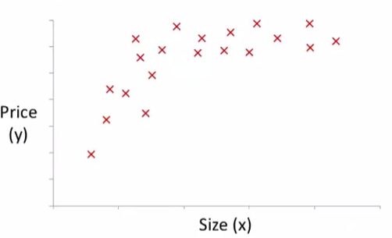

Polynomial regression - example (cont.)
The definition of adequate features involves both insight and knowledge of the problem domain.
Notes:
Esse exemplo ilustra que podemos transformar características de forma bastante flexível. O exemplo apresenta uma escolha razoável de hipótese, usando a raiz quadrada do tamanho da casa.

Slide 42
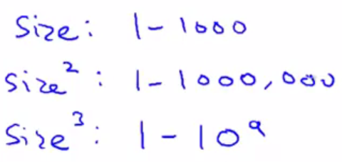
Polynomial regression vs feature scaling
Scaling features is even more important in the context of polynomial regression.

