Slide 1
Introduction to Machine learning
Prof. Eduardo Bezerra
(CEFET/RJ)
ebezerra@cefet-rj.br

Slide 2
Logistic Regression

Slide 3
Visão Geral
Classificação
Representação de Hipóteses
Fronteira de Decisão
Função de Custo
Aprendizados dos parâmetros
Classificação multiclasses

Slide 4
Logistic regression
An popular and simple machine learning algorithm for classification.
Goal: model the probability of a Bernoulli random variable given a training dataset.
In this lecture, we will see how to apply logistic regression to binary classification problems…

Slide 5
Binary classification - examples
Email: spam/ham?
Online transactions: fraudulent/legitimate?
Tumor: malign/benign?
0: “negative class” (e.g., not spam)
1: “positive class” (e.g., spam)

Slide 6
Representation
Here, we study how we represent hypotheses in Logistic Regression.

Slide 7
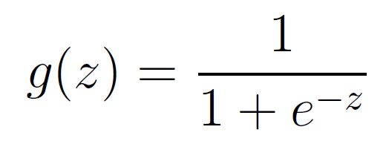
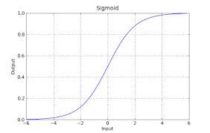
Representation of hypotheses
We need a representation such that
sigmoid function
logistic function

Slide 8
Interpretation
Example:
Probability(malign) = 70%
Notes:
Probabilidade de que y = 1, parametrizado por \theta

Slide 9
Decision boundary
Since
g(z) ≥ 0.5 when z ≥ 0
g(z) < 0.5 when z < 0
Then
predict y=1 when
predict y=0 when

Slide 10
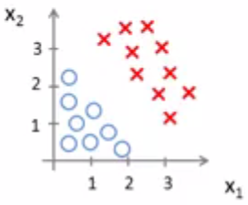
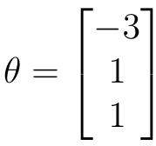
Example – linear boundary
Suponha que

Slide 11
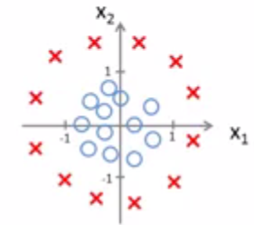
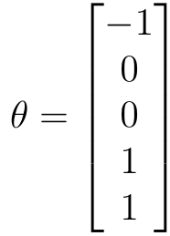
Example – nonlinear boundary
Suponha que
Notes:
Esse exemplo ilustra o fato de que a entrada para a função sigmoide não precisa ser linear.
De fato, por meio da adição de características não lineares (features), podemos construir fronteiras de decisão mais complexas.

Slide 12
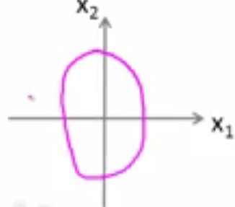
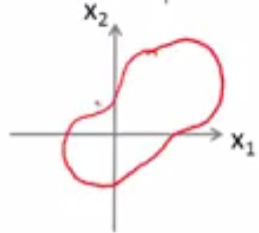
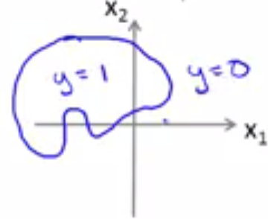
Example – nonlinear boundary
Notes:
Esse exemplo ilustra que fronteiras de decisão ainda mais complexas podem ser ajustadas a um conjunto de dados. De fato, com uma escolha específica de parâmetros, é possível que a Regressão Logística produza fronteiras de decisão similares às ilustradas nessa página.

Slide 13
Evaluation (cost function)
Here, we present the cost function for logistic regression.

Slide 14
Model evaluation
Given:
Training set
m examples
Hypothesis (model) general form:
How to evaluate a model?

Slide 15
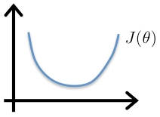
Cost function – Linear Regression
Interpretation: penalty applied to the algorithm concerning the i-th example.
convex function

Slide 16
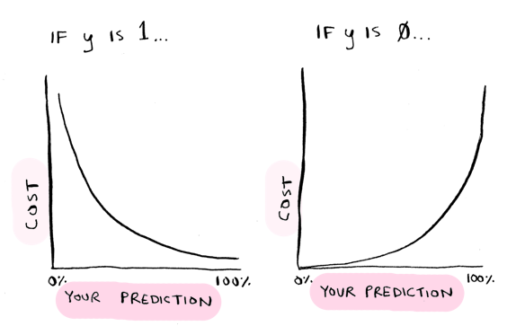
Cost function – Logistic Regression
Função de custo para a regressão logística:
Notes:
Fonte da figura: http://adit.io/posts/2016-03-13-Logistic-Regression.html

Slide 17
Cost function – intuition
Cost is zero if hypothesis and prediction match:
If prediction and hypothesis do not match:
Therefore: algorithm is penalized when it makes a misclassification.

Slide 18
Simplifying the cost function
Note that
when , the second term is zero.
when , the first term is zero.
Cost function for logistic regression:

Slide 19
Optimization
Here, we study how we can minimize the cost function of Logistic Regression by using the gradient descent algorithm.

Slide 20
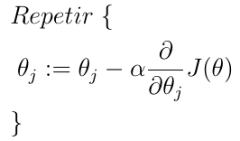
Optimization
GD minimizes :

Slide 21
Optimization
By computing the partial derivative of :
Notes:
A prova é simples e envolve a Regra da Cadeia, do Cálculo: https://en.wikipedia.org/wiki/Chain_rule

Slide 22
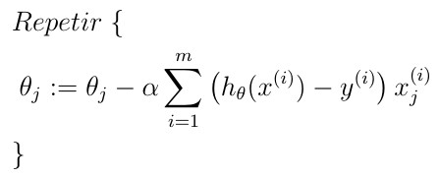
Optimization
So, to minimize , we do:

Slide 23
Final Remarks
The discussion on the following topics that we have made in the context of linear regression also applies to logistic regression
debugging the gradient
value of the learning rate
Feature scaling
Feature engineering

Slide 24
Multiclass Classification
Here we study how logistic regression can be applied in a classification problem with multiple classes.
Notes:
Wikipedia: “In machine learning, multiclass or multinomial classification is the problem of classifying instances into one of three or more classes. (Classifying instances into one of the two classes is called binary classification.)”
Wikipedia: “Multiclass classification should not be confused with multi-label classification, where multiple labels are to be predicted for each instance.”

Slide 25
Multiclass classification - motivation
Organization of articles in a news portal: sports, humor, politics, ...
Medical diagnosis: not sick, flu, cold, dengue
Weather conditions: sunny, cloudy, rainy
Morphological classification of galaxies
In all of these examples, y may assume values in a small set of size larger than 2.

Slide 26
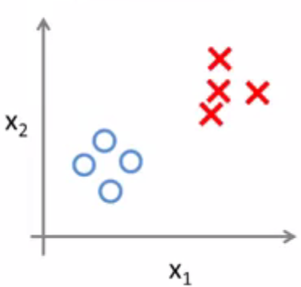
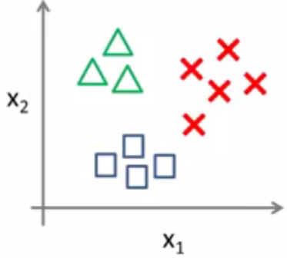
Multiclass classification - example
Binary classification
Multiclass classification
Ideia: one-vs-all classification

Slide 27
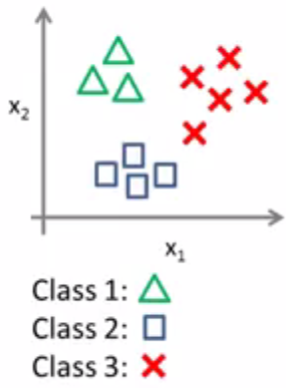
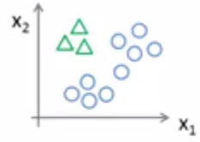
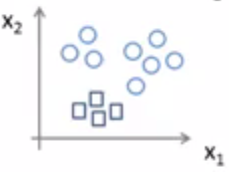
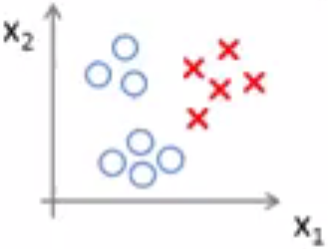
Multiclass classification - example

Slide 28
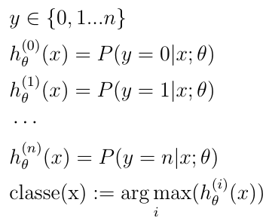
Multiclass classification - procedure
Given a classification problem with n classes:
Train a classifier for each of the n classes
To predict the class of a new example x, select the class which maximizes the corresponding hypothesis.

