Slide 1
Introduction to Machine learning
Prof. Eduardo Bezerra
(CEFET/RJ)
ebezerra@cefet-rj.br

Slide 2
Basic concepts

Slide 3
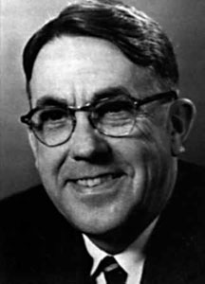
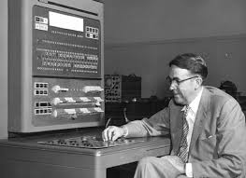
Machine Learning (to play Checkers)
Coined the term Machine Learning (“Field of study that gives computers the ability to learn without being explicitly programmed.”)
“it will learn to play a better game of checkers than can be played by the person who wrote the program.”
search tree
alpha-beta pruning
scoring functions
1959
Arthur Samuel
Notes:
https://history-computer.com/ModernComputer/thinkers/Samuel.html
https://en.wikipedia.org/wiki/Arthur_Samuel#Computer_checkers_(draughts)_development
TeX programmer

Slide 4
Machine Learning - definition
“A computer program is said to learn from experience E with respect to some task T and some performance measure P, if its performance on T, as measured by P, improves with experience E.”
1998
Tom Mitchell
Notes:
Tom Mitchel, from CMU, came up with a concise definition of ML.
http://www.cs.cmu.edu/~tom/

Slide 5
Machine Learning – definition (cont.)
Suppose some computer program watches which objects you mark as galaxy/star, and based on that learns how to tell these two objects apart.
In such context:
T → star/galaxy separation
E → several labeled examples (images or catalog)
P → purity/completeness

Slide 6
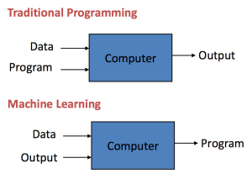
ML vs traditional programming
Traditional programming: data and program is run on the computer to produce the output.
The ML way: data and output is run on the computer to create a program. This program can be used in traditional programming.
Credits: Pedro Domingos

Slide 7
Machine Learning (in one page!)
7
Training data
learner
New data
model
prediction
Notes:
Fonte: deeplearning-thepastpresentandfutureofartificialintelligence-151205235804-lva1-app6891.pdf
Machine Learning is a type of Artificial Intelligence that provides computers with the ability to learn without being explicitly programmed.

Slide 8
Terminology
Training set
Training sample (training instance or training example).
Feature
Target function
Hypothesis functions (hypothesis space)
Model
Learner (learning algorithm)
Notes:
Training sample: A training sample is a data point x in an available training set that we use for tackling a predictive modeling task. For example, if we are interested in classifying emails, one email in our dataset would be one training sample. Sometimes, people also use the synonymous terms training instance or training example.
Target function: In predictive modeling, we are typically interested in modeling a particular process; we want to learn or approximate a particular function that, for example, let's us distinguish spam from non-spam email. The target function f(x) = y is the true function f that we want to model. In (supervised) machine learning, the goal is to select a function from the uncountable hypothesis functions that is closest to the target function.
Hypothesis: A hypothesis is a certain function that we believe (or hope) is similar to the true function, the target function that we want to model. In context of email spam classification, it would be the rule we came up with that allows us to separate spam from non-spam emails.
Model: In machine learning field, the terms hypothesis and model are often used interchangeably. In other sciences, they can have different meanings, i.e., the hypothesis would be the "educated guess" by the scientist, and the model would be the manifestation of this guess that can be used to test the hypothesis.
Learning algorithm: Again, our goal is to find or approximate the target function, and the learning algorithm is a set of instructions that tries to model the target function using our training dataset. A learning algorithm comes with a hypothesis space, the set of possible hypotheses it can come up with in order to model the unknown target function by formulating the final hypothesis.
Classifier: A classifier is a special case of a hypothesis (nowadays, often learned by a machine learning algorithm). A classifier is a hypothesis or discrete-valued function that is used to assign (categorical) class labels to particular data points. In the email classification example, this classifier could be a hypothesis for labeling emails as spam or non-spam. However, a hypothesis must not necessarily be synonymous to a classifier. In a different application, our hypothesis could be a function for mapping study time and educational backgrounds of students to their future SAT scores.

Slide 9
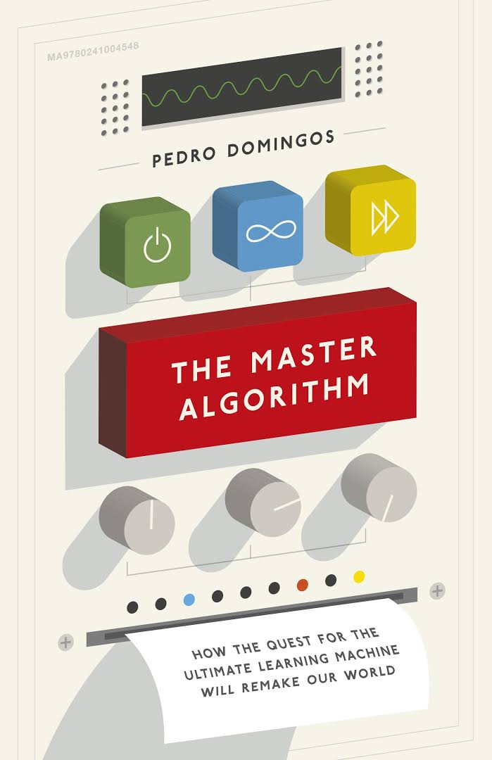
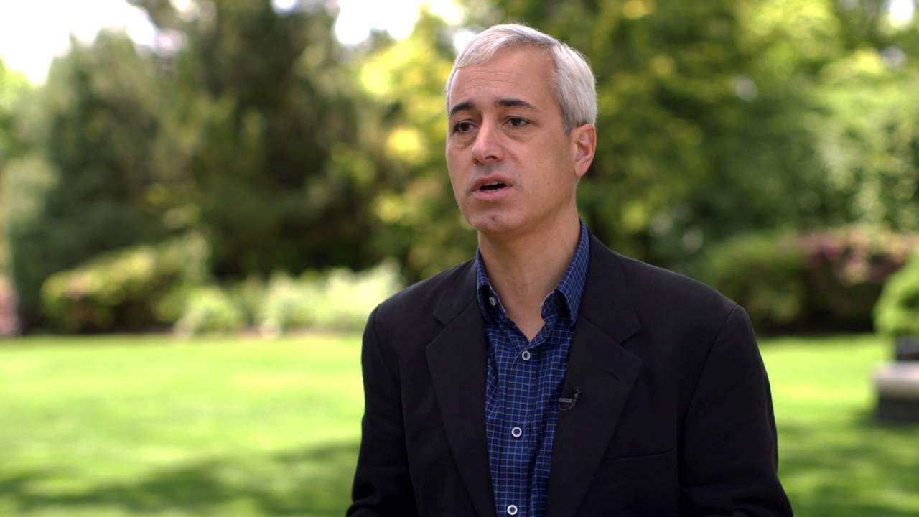
ML Tribes
Symbolists (rule-based systems)
Evolutionists (evolutionary computation, GAs)
Analogists (SVMs, k-NN, …)
Bayesians (Bayes update rule)
Connectionists (ANNs)
Pedro Domingos
Notes:
Pedro Domingos: "The Master Algorithm" | Talks at Google
https://www.youtube.com/watch?v=B8J4uefCQMc
“The Master Algorithm: How the Quest for the Ultimate Learning Machine Will Remake Our World is a book by Pedro Domingos released in 2015. Domingos wrote the book in order to generate interest from people outside the field.”

Slide 10
Families of ML tasks
Supervised learning
Unsupervised learning
Semi-supervised learning
Reinforcement learning

Slide 11
Supervised learning
Given examples of a function (x, f(x))
Predict function f(x) for new examples x
Discrete f(x) → classification
Continuous f(x) → regression
f(x) = probability(x) → x = probability estimation
Face recognition
The x are bitmaps of peoples faces.
The f(x) is to assign a name to the face.
Disease diagnosis
The x are the properties of the patient.
The f(x) is the disease they suffer from.
Source: CSEP546

Slide 12
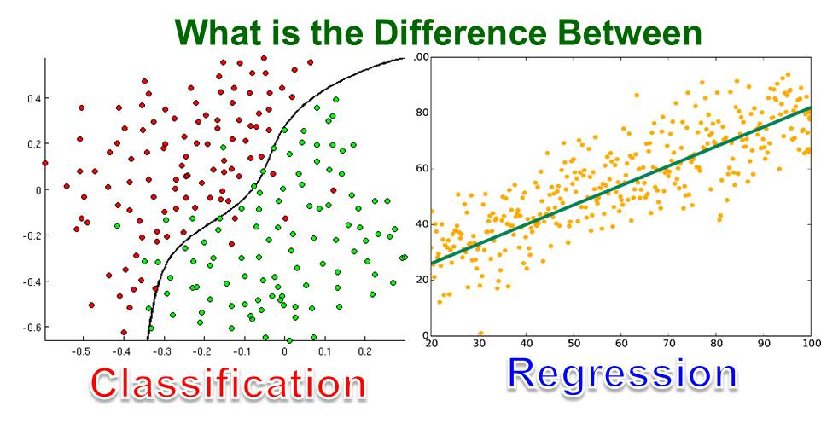
Supervised learning (classification vs regression)
http://kindsonthegenius.blogspot.com/2018/01/what-is-difference-between.html

Slide 13
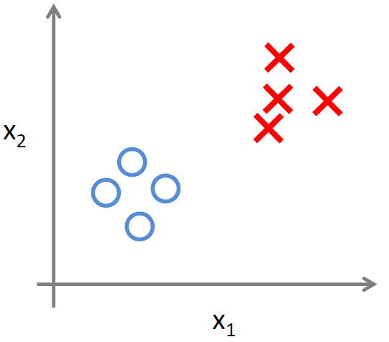
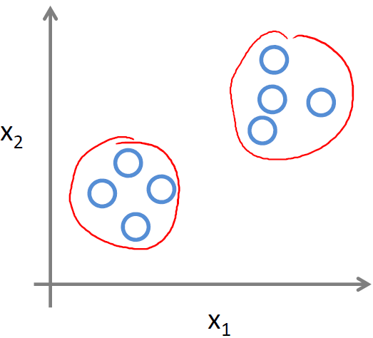
Unsupervised learning

Slide 14
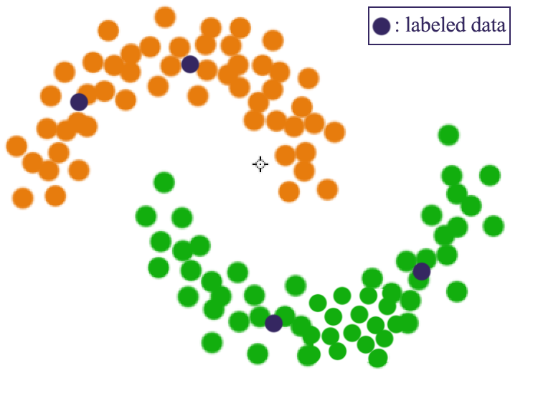
Semi-supervised learning
Training data includes a few desired outputs.

Slide 15
Reinforcement Learning
Agent
State: s
Reward: r
Actions: a
Environment
Basic ideas:
Agent receives feedback in rewards form for actions taken
Utility is defined by the reward function
Agent must (learn to) act in such a way to maximize expected rewards
Learning is based on looking at sample results!

Slide 16
Components of a learning algorithm

Slide 17
Components
Every ML algorithm contains three components:
Representation: which language to use to represent a program.
Evaluation: how to evaluate the quality of a program.
Optimization: how to generate candidate programs.
Notes:
program = hypothesis

Slide 18
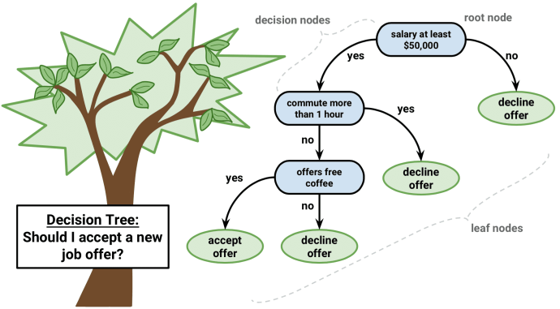
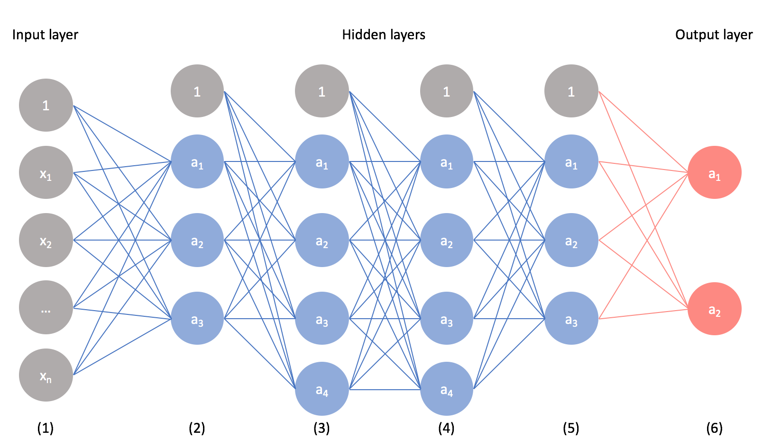
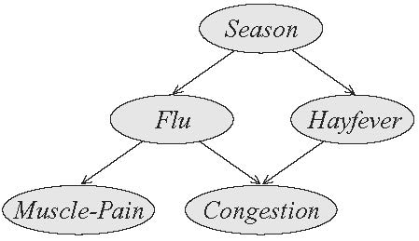
Components - representation
Regression functions
Decision trees
Neural networks
Instances
Graphical models
Rule sets
Ensembles
....

Slide 19
Components - evaluation
Accuracy, precision
Precision, recall, F1 measure
Squared errors
Likelihood
Posterior probability
Cost/utility
Margin
KL divergence
....

Slide 20
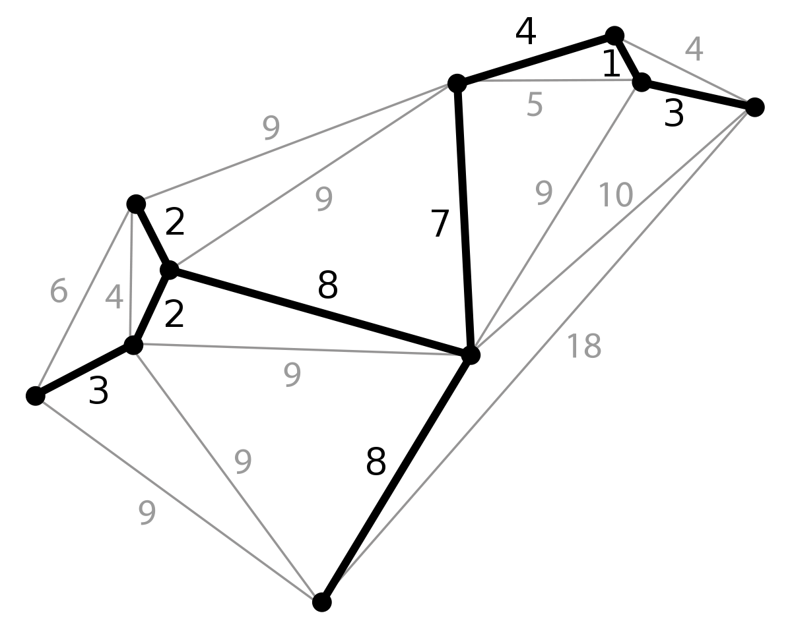
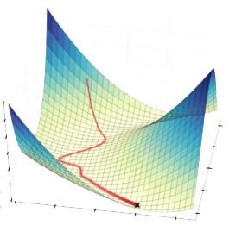
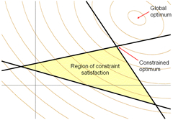
Components - optimization
Combinatorial optimization
e.g., Greed search
Convex optimization
e.g., Gradient descent
Constrained optimization
e.g., Linear programming

