Slide 1
Neural Models for Word Embedding
Prof. Eduardo Bezerra
(CEFET/RJ)
ebezerra@cefet-rj.br

Slide 2
Summary
Neural Nets (quick overview)
Word2vec
Language models
Skip-gram

Slide 3
Neural Nets - Representation

Slide 4
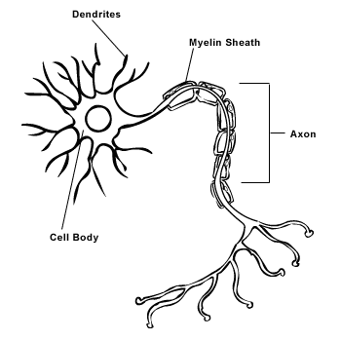
Model of a biological neuron
http://creationwiki.org/Neuron

Slide 5
Artificial Neuron
The artificial neuron is a model inspired by the real
In an artificial neuron:
input are features
each feature has an associated weight
weighted sum of features is called neuron pre-activation
value produced in pre-activation goes through a non-linearity to produce neuron activation

Slide 6
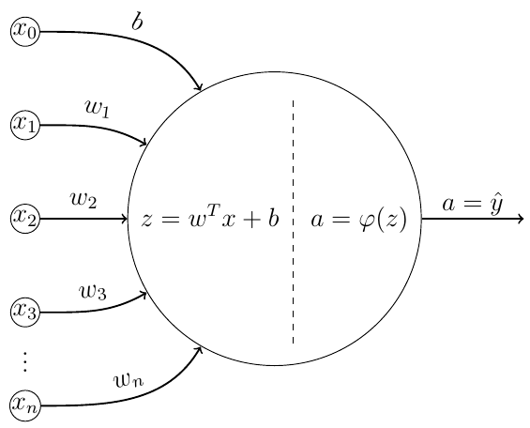
Artificial Neuron
The artificial neuron is a model inspired by the real one (biological neuron).

Slide 7
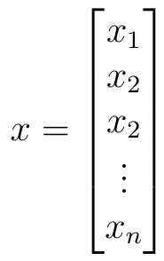
Artificial Neuron - input
features

Slide 8
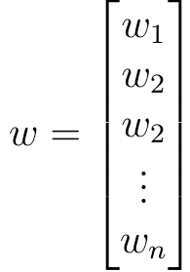
Artificial Neuron – weights
weights
(aka parameters)

Slide 9
Artificial Neuron – pre-activation
pre-activation

Slide 10
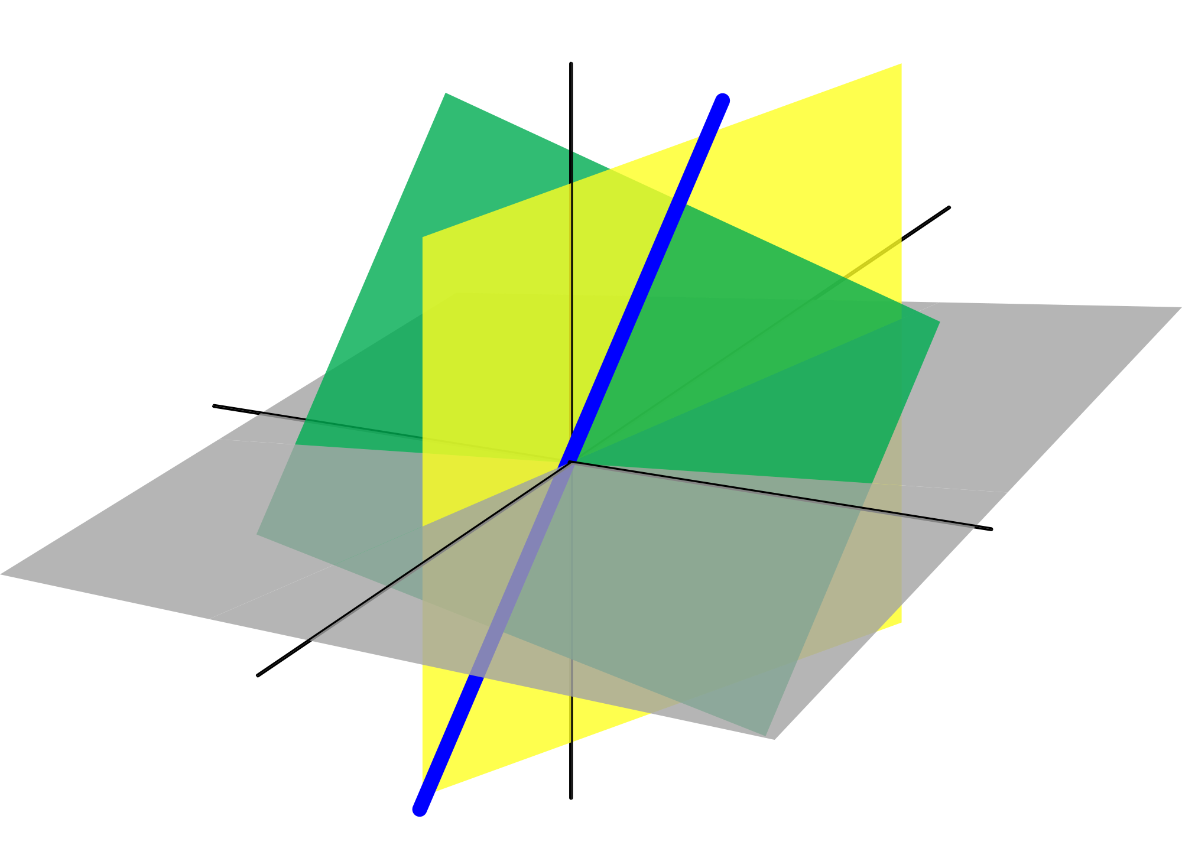
Artificial Neuron – activation function
activation
Nonlinearities are required so that the network can learn complex representations of the data.
"The composition of linear transformations is also a linear transformation"
10
Notes:
activation function

Slide 11
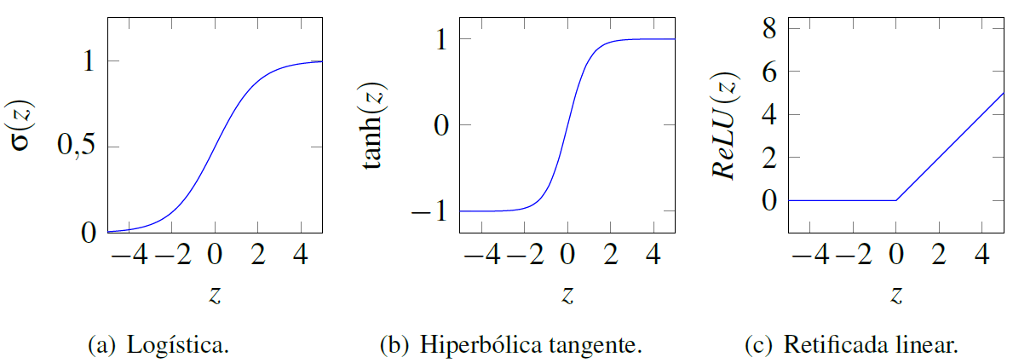
Artificial Neuron – activation functions

Slide 12
Artificial Neuron – activation functions
Sigmoid Logistic
Tangent Hyperbolic
ReLU
softmax

Slide 13
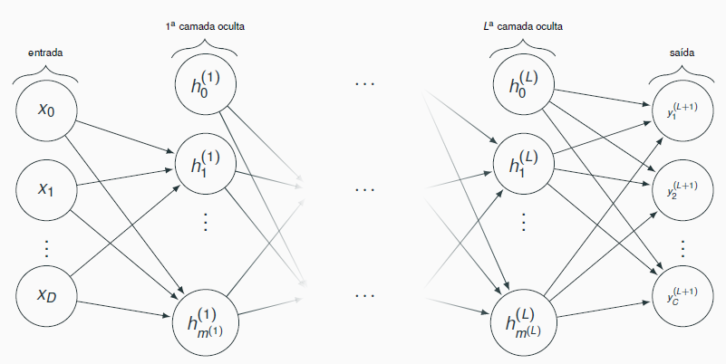
softmax
13
Maps the NN outputs to a probability distribution.
3
0,7
2
0,2
0,4
0,1
Notes:
----- Meeting Notes (03/10/16 19:01) -----
quais as principais propriedades da softmax?

Slide 14
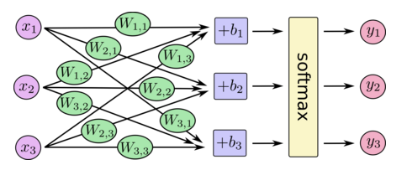
softmax
14
Maps the NN outputs to a probability distribution.
Fonte: https://www.tensorflow.org/versions/r0.9/tutorials/mnist/beginners/index.html
Notes:
y_i = o \left( a_i^{(L+1)} \right) = \frac{e^{a_i^{(L+1)}}}{\sum_{j = 1}^{C} e^{a_j^{(L+1)}}}

Slide 15
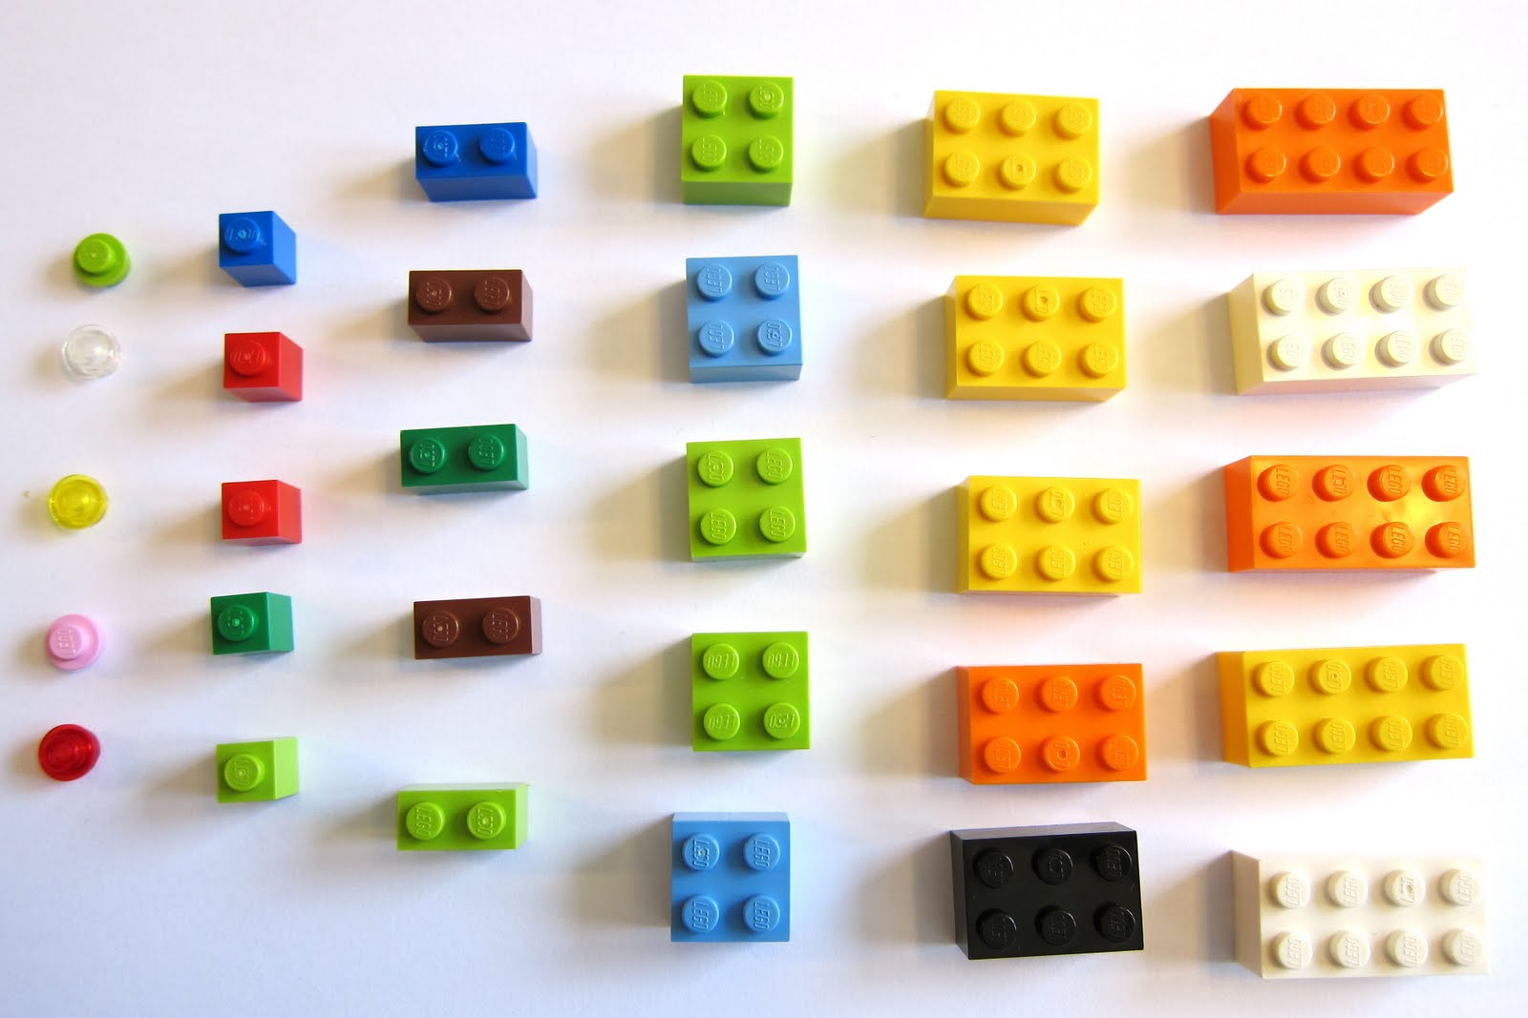
Artificial Neural Net
It is possible to architect arbitrarily complex networks using the artificial neuron as the basic component.

Slide 16
Artificial Neural Net
Feedforward Neural Network

Slide 17
Kinds of layers
In an ANN:
input layer are the input patterns (features);
output layer is result of the computation performed;
other layers are called hidden layers.
Amount of layers and amount of units (neurons) per layer are part of the ANN architecture.

Slide 18
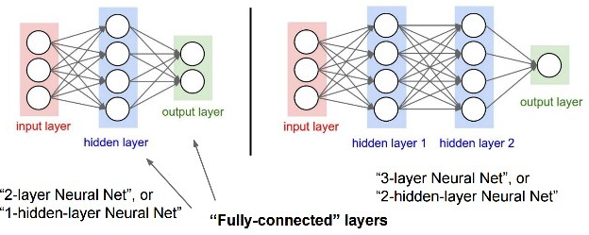
Kinds of layers - example

Slide 19
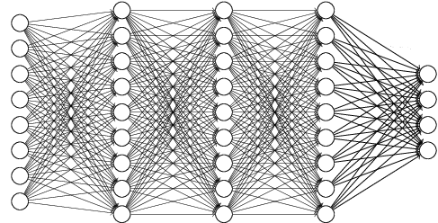
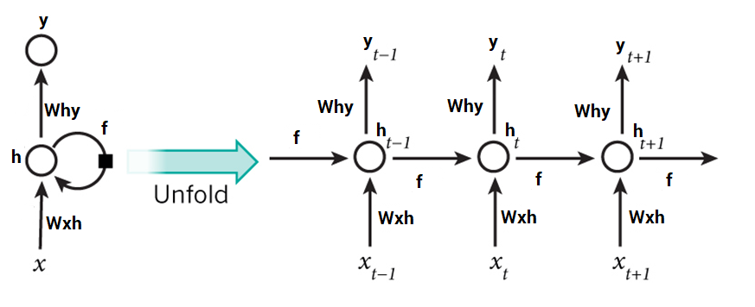
Kinds of ANNs
Fully connected x not fully connected
Recurrent x feed forward

Slide 20
ANNs - notation
Pre-activation:
Activation:

Slide 21
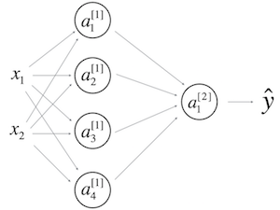
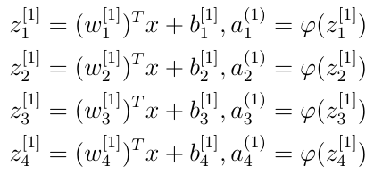
ANNs – notation - example
e.g., in a two-layer ANN:
Computations in the first layer:

Slide 22
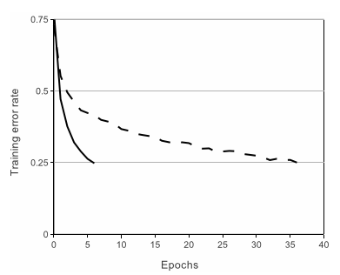
Rectified linear units, ReLU
Convnet of 4 layers with ReLUs.
CIFAR-10 (60K, 32x32 imgs)
It reaches the same error level 6 times faster than tanh.
ImageNet Classification with Deep Convolutional Neural Networks, 2012.
Notes:
Figure 1: A four-layer convolutional neural network with ReLUs (solid line) reaches a 25% training error rate on CIFAR-10 six times faster than an equivalent network with tanh neurons (dashed line). The learning rates for each net- work were chosen independently to make train- ing as fast as possible. No regularization of any kind was employed. The magnitude of the effect demonstrated here varies with network architecture, but networks with ReLUs consis- tently learn several times faster than equivalents with saturating neurons.
The CIFAR-10 dataset consists of 60000 32x32 colour images in 10 classes, with 6000 images per class. There are 50000 training images and 10000 test images.

Slide 23
Neural Nets - Evaluation

Slide 24
Cost function
The error signal is the difference between y^{(i)} and output produced for x^{(i)}.
measures the difference between the network predictions and the desired values.
A cost function must provide a way to measure the error signal for a set o training examples.

Slide 25
Cost function J(W,b)
Cost function: error of the network considering all the examples.
function of the set of all weights and bias of the network.

Slide 26
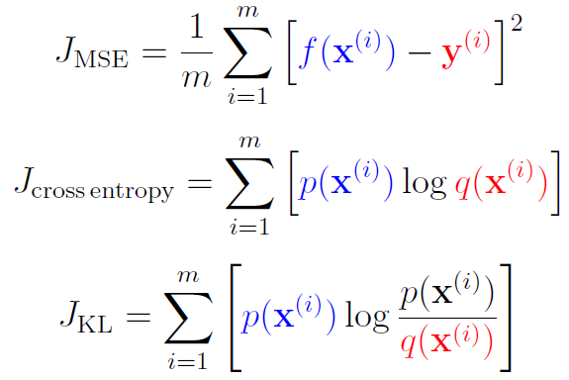
Some (unregularized) cost functions
Mean square error
Cross entropy error
Kullback-Leibler divergence
Notes:
See also → https://medium.com/machine-learning-for-li/a-walk-through-of-cost-functions-4767dff78f7

Slide 27
Neural Nets - Optimization (learning, training)

Slide 28
Training
Given a training set of the form
training an ANN corresponds to using this set to adjust the parameters of the network, so that the training error is minimized.
So, training of an ANN is an optimization problem.
Notes:
$\textbf{x}^{(i)}$ é o vetor de características está associado ao componente $\textbf{y}^{(i)}$.
cujo objetivo é minimizar o erro cometido pela rede, quando considerados todos os exemplos de treinamento.

Slide 29
Training
The error signal (computed with a cost function) is used during training to gradually change the weights (parameters), so that the predictions are more accurate.
Propagation of the example through layers from input to output (→)
Pick a training example
Propagation of the error signal through the layers from the output to the input (←)
Update parameters
W, b.

Slide 30
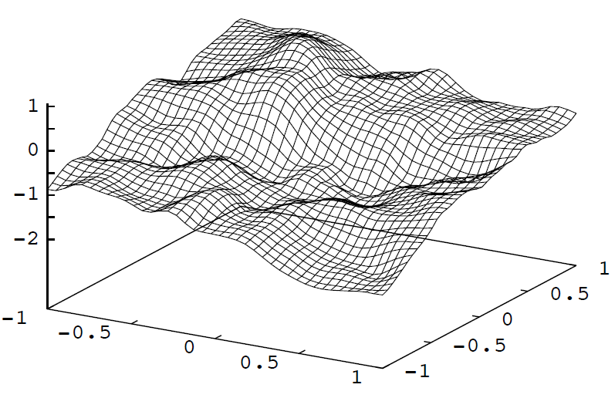
Stochastic Gradient Descent (SGD)
SGD allows to traverse the space of parameters of a neural network in search for a local minimum.
Source: David McKay, ITPRNN
Notes:
Gradient Descent finds the (local) the minimum of the cost function (used to calculate the output error) and is used to adjust the weights.
(figura da direita)
This is from a two-layer feedforward network, two input units, one output unit, very large number of hidden unit. Weights are
chosen randomly from a Gaussian distribution, to get an idea of functions than an ANN “likes” to represent. Source: David McKay, ITPRNN
%http://yyue.blogspot.com.br/2015/01/a-brief-overview-of-deep-learning.html
%Fun story: researchers believed, for many years, that SGD cannot train deep neural networks from random initializations. Every time they would try it, it wouldn’t work. Embarrassingly, they did not succeed because they used the “small random weights” for the initialization, which works great for shallow nets but simply doesn’t work for deep nets at all. When the nets are deep, the many weight matrices all multiply each other, so the effect of a suboptimal scale is amplified.

Slide 31
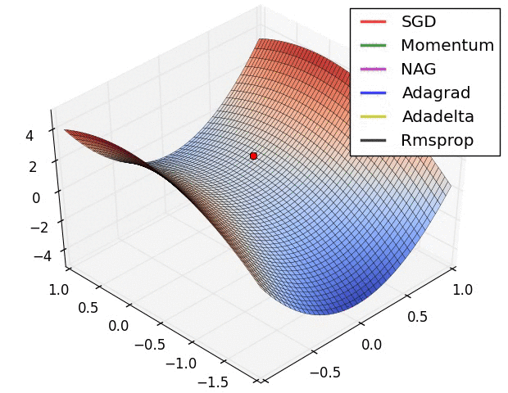
Alternatives to SGD
Source: http://sebastianruder.com/optimizing-gradient-descent/
Notes:
Área de pesquisa ativa: novos métodos de otimização

Slide 32
Neural Nets - Backpropagation

Slide 33
Error back-propagation
Consider that the output produced for x^{(i)} is different from y^{(i)} (i.e., there is an nonzero error signal).
Credit Assignment Problem
Then it is necessary to determine the responsibility of each parameter (weight) of the network by this error...
... and change these parameters for the purpose of reducing the error.

Slide 34
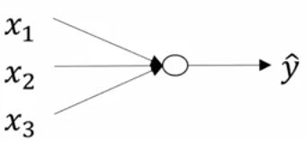
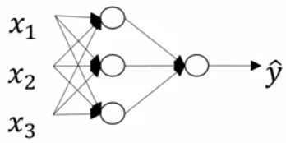
Error back-propagation
In an ANN with at least one hidden layer, there is no direct supervision signal for these layers.
Logistic regression

Slide 35
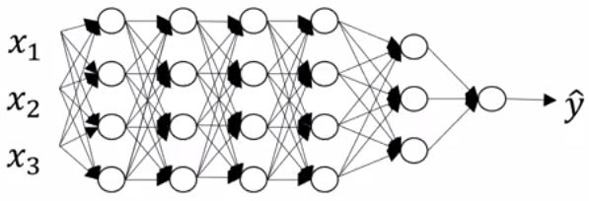
Error back-propagation
This problem gets worse as the amount of hidden layers increases.

Slide 36
Backpropagation
Algorithm invented many times...
Recursively propagates the error signal from the output layer through the hidden layers, to the input layer.
Used in conjunction with some optimization algorithm (e.g., SGD) to gradually minimize network error.
Humelhart et al. Learning representations by back-propagating errors, 1986.
Notes:
Redescoberto muitas vezes: 60’s, 1970, 1982 (Werbos), 1986 (Humelhart, Williams & Hinton)
backprop : para cada um dos pesos, o algoritmo decide se deve AUMENTAR ou DIMINUIR um pouco, de tal forma que, para o lote de exemplos usados, a resposta melhora.
calcular a derivada de g_i com relação a um parâtmetro específico da RNA, por exemplo \theta_k

Slide 37
Backpropagation
Backpropagation, an abbreviation for “backward propagation of errors”, is a common method of training artificial neural networks used in conjunction with an optimization method such as gradient descent. The method calculates the gradient of a loss function with respect to all the weights in the network. The gradient is fed to the optimization method which in turn uses it to update the weights, in an attempt to minimize the loss function.
--Frederik Kratzert
Notes:
https://kratzert.github.io/2016/02/12/understanding-the-gradient-flow-through-the-batch-normalization-layer.html

Slide 38
ANN training with Backpropagation
Set initial weights for the network
Present an example and get the result
For each layer (from the last):
Calculate the error for each neuron
Update the weights (with SGD or variant)
Propagate this error to the previous layer
Repeat with other examples until convergence

Slide 39
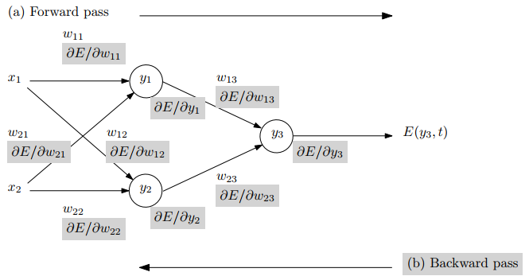
Backpropagation – example
Fonte: Automatic Differentiation in Machine Learning: a Survey (https://arxiv.org/pdf/1502.05767.pdf)

Slide 40
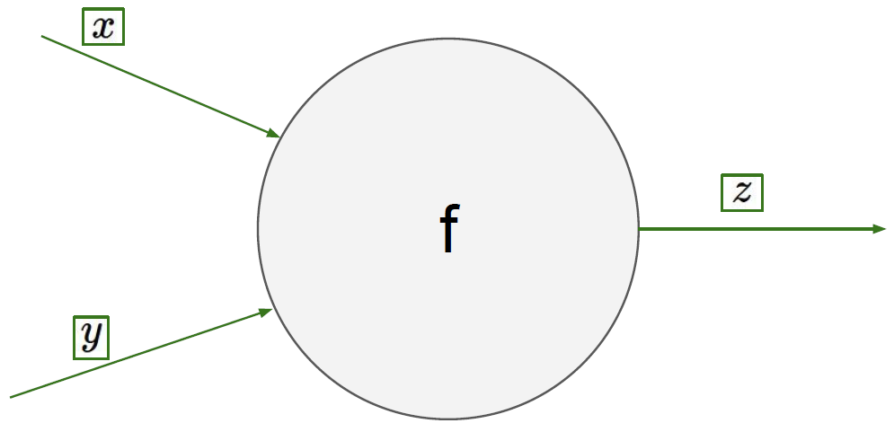
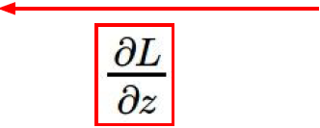
Backpropagation
Fonte: CS231n

Slide 41
word2vec

Slide 42
Credit where credit is due
The original papers from Mikolov et al.
CS 224D: Deep Learning for NLP
https://cs224d.stanford.edu/lecture_notes/notes1.pdf
McCormick, C. (2016). Word2Vec Tutorial.
http://www.mccormickml.com

Slide 43
Language Models (Unigrams, Bigrams, etc.)
A model that assigns a probability to a sequence of tokens.
A good language model gives
(syntactically and semantically) valid sentences a high probability.
gives low probability to nonsense.

Slide 44
Language Models (Unigrams, Bigrams, etc.)
A model that assigns a probability to a sequence of tokens.
A good language model gives
(syntactically and semantically) valid sentences a high probability.
gives low probability to nonsense.

Slide 45
Language Models (Unigrams, Bigrams, etc.)
Mathematically, we can apply a LM to any given sequence of n words:

Slide 46
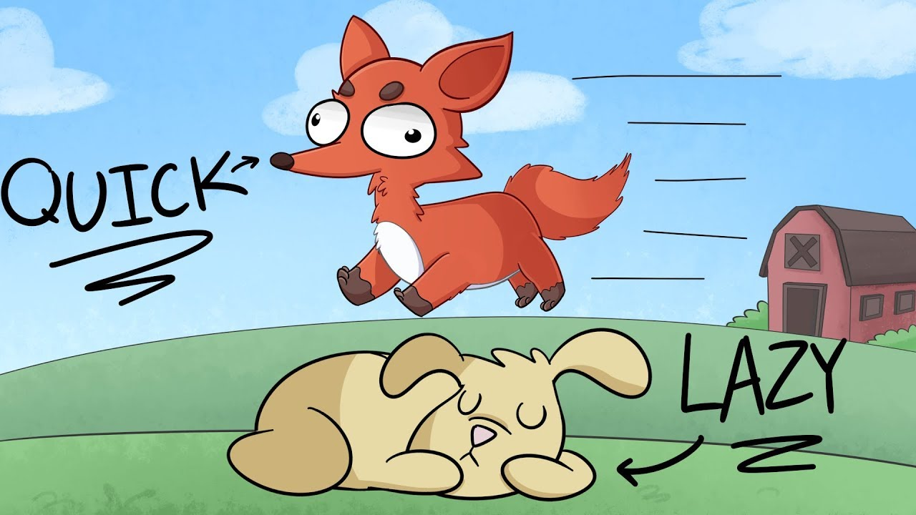
Language Models (Unigrams, Bigrams, etc.)
An example:
"The quick brown fox jumps over the lazy dog."
Another example:
"The quik brown lettuce over jumps the lazy dog.“

Slide 47
Language Models (Unigrams, Bigrams, etc.)
Unigram model
Bigram model
But, how to learn these probabilities?

Slide 48
word2vec
Efficient Estimation of Word Representations in Vector Space, September 7th, 2013.
Distributed Representations of Words and Phrases and their Compositionality, October 16th, 2013.
https://research.fb.com/people/mikolov-tomas/
https://code.google.com/archive/p/word2vec/

Slide 49
The word2vec trick
word2vec uses a trick:
A single hidden layer neural network is trained to perform a certain “fake” task.
But this NN is not actually used!
Instead, the goal is to learn the weights of the hidden layer– these weights are the “word vectors”.

Slide 50
The fake tasks
Skip-gram: predicting surrounding context words given a center word.
CBOW: predicting a center word form the surrounding context.

Slide 51
Skip-gram

Slide 52
Skip-gram
The task: given a specific word w in the middle of a sentence (the input word), look at the words nearby and pick one word at random.
We then train the network to produce the probability (for every word in the vocabulary) of being nearby w.
“nearby” means there is actually a "window size" hyperparameter (typical value: 5)
Notes:
A typical window size: 5 (5 words behind and 5 words ahead; 10 in total).

Slide 53
Skip-gram
Output probabilities are going to relate to how likely it is to find each vocabulary word nearby our input word w.
For example, say w = “Africa”
output probabilities should be much higher for related words (e.g. “lion”, “zebra”) than for unrelated words (e.g. “bear”, “kangaroo”).

Slide 54
Training examples (word pairs)
The training examples will be word pairs taken from the input corpus.
During training, the network will learn parameters that capture the statistics related to the number of times each pairing shows up.

Slide 55
Training examples (word pairs)
For example, suppose the network gets many more training samples of (“Soviet”, “Union”) than (“Soviet”, “Sasquatch”).
After training, if the NN is given the word “Soviet”, it will output a much higher probability for “Union” (or “Russia”) than it will for “Sasquatch”.

Slide 56
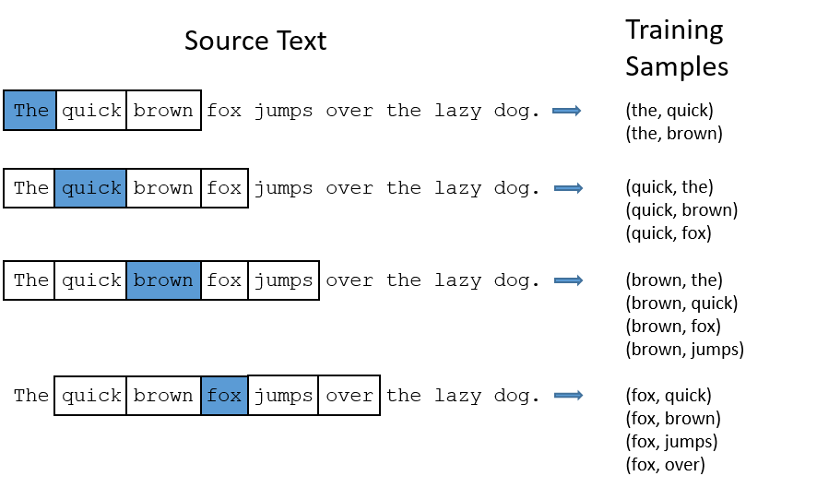
Training examples (word pairs)
“The quick brown fox jumps over the lazy dog.”
window size = 2.
The word highlighted in blue is the input word w.

Slide 57
One hot encoding
But, during training, we cannot provide the NN with the text of the words.
We need to use some vector representation for each word in the vocabulary → one hot enconding.

Slide 58
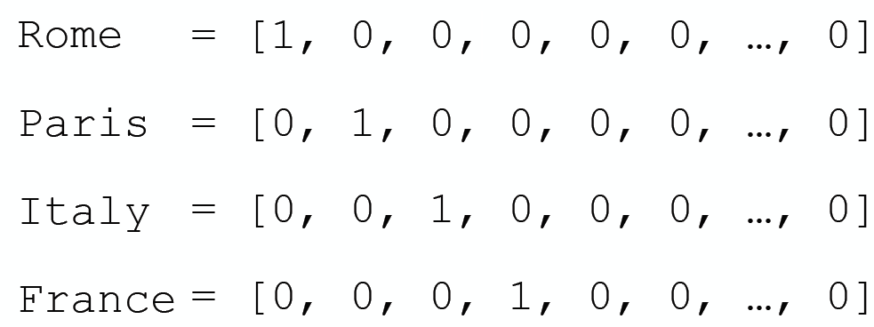
One hot encoding
Credits: Marco Bonzaninin
Notes:
https://speakerdeck.com/marcobonzanini/word-embeddings-for-natural-language-processing-in-python-at-london-python-meetup

Slide 59
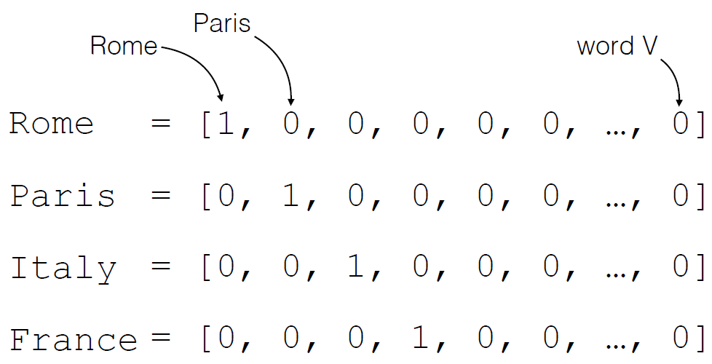
One hot encoding
Credits: Marco Bonzaninin

Slide 60
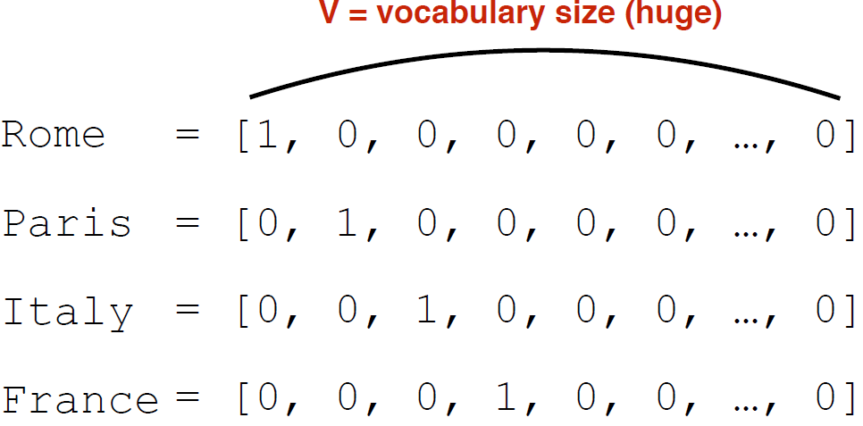
One hot encoding
Credits: Marco Bonzaninin

Slide 61
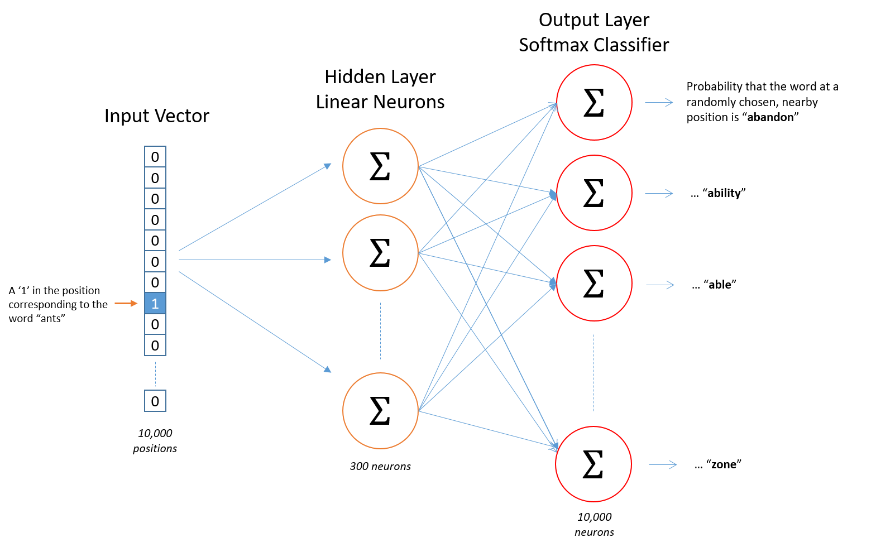
Skip-gram NN architecture
There is no activation function on the hidden layer neurons, …

Slide 62
Skip-gram NN architecture
…, but the output neurons use softmax.

Slide 63
Skip-gram NN architecture
The amount of neurons in the hidden layer (a hyperparameter) determines de size of the embedding.

Slide 64
The hidden layer
Multiplying a 1 x n one-hot vector by a n x d matrix (the hidden layer) will effectively select the matrix row corresponding to the “1”.
So, the output of the hidden layer is just the “word vector” for the input word → the hidden layer plays the role of a lookup table.

Slide 65
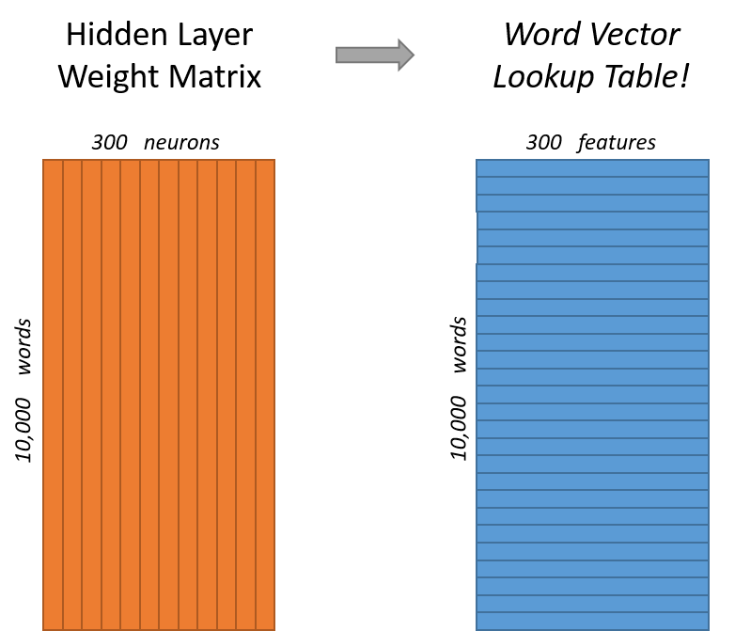
The hidden layer
The output of the hidden layer is just the “word vector” for the input word.
That is the matrix we really want!

Slide 66
The output layer
The 1 x d word vector (coming from the hidden layer) then gets fed to the output layer.
The output layer has |V| neurons and is a softmax regression classifier.
Notes:
Info about softmax regression: http://ufldl.stanford.edu/tutorial/supervised/SoftmaxRegression/
Figure: an illustration of the computation made by the output neuron for the word “car”.

Slide 67
Skip-gram captures context similarity
If two words w_{j} and w_{k} have similar “contexts” (i.e., similar words are likely to appear around them), then the model needs to output very similar results for them.
One way for the network to do this is if the word vectors for w_{j} and w_{k} are similar.
So, if two words have similar contexts, our network is motivated to learn similar word vectors for them.

Slide 68
A drawback of skip-gram
The resulting trained model contains a huge amount of weights.
e.g., d = 300 and |V| = 10,000, that’s 3M weights in the hidden layer and output layer each!
Training (optimizing) a skip-gram model on a large corpus would be prohibitive.

Slide 69
Three inovations
Learn phrases from the corpus.
Subsample frequent words to decrease the number of training examples.
Modify the optimization objective with a technique they called “Negative Sampling”, which causes each training sample to update only a small percentage of the model’s weights.
Notes:
https://arxiv.org/pdf/1310.4546.pdf

Slide 70
Learning Phrases
A word pair like “Boston Globe” (a newspaper) has a much different meaning than the individual words “Boston” and “Globe”.
So it makes sense to treat any occurrences of “Boston Globe” as a single word with its own word vector representation.

Slide 71
Learning Phrases
In an experiment from the 2nd word2vec paper:
a model was trained on 100 billion words from a Google News dataset, using d=300.
the addition of phrases to the model reduced the vocabulary size to 3 million words.
This (pre-trained) model can be freely downloaded.
Phrase detection is also covered in the paper.
Notes:
Pre-trained model → https://drive.google.com/file/d/0B7XkCwpI5KDYNlNUTTlSS21pQmM/edit?usp=sharing
Their implementation of phrase detection is also shared.

Slide 72
Learning Phrases
Each pass of their phrase detection tool only looks at combinations of 2 words.
But it can executed multiple times to get longer phrases.
So, the first pass will pick up the phrase “New_York”, and then running it again will pick up “New_York_City” as a combination of “New_York” and “City”.

Slide 73
Subsampling frequent words
Two issues with common words like “the”:
When looking at word pairs, (“fox”, “the”) doesn’t tell us much about the meaning of “fox”.
We will have many more samples of (“the”, …) than we need to learn a good vector for “the”.
A “subsampling” scheme addresses this...
Notes:
Because “the” appears in the context of pretty much every word.

Slide 74
Subsampling of frequent words
Example: for a window size of 10, if a specific instance of “the” is removed:
As we train on the remaining words, “the” will not appear in any of their context windows.
We’ll have 10 fewer training samples where “the” is the input word.
This has a huge effect on the size of the training set.

Slide 75
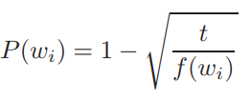
Subsampling of frequent words
“subsampling” scheme:
For each word found in the corpus, there is a chance that it will be discarded.
The probability that a word w_{i} will be discarded is related its frequency:

Slide 76
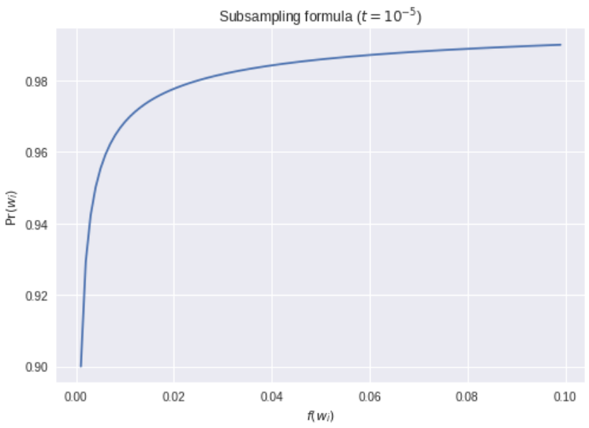
Subsampling of frequent words

Slide 77
Negative sampling
Train a NN means to iterate on: “take each x^{(i)} and adjust all of the weights slightly so that the NN predicts x^{(i)} more accurately”.
i.e., each training sample will tweak all of the weights in the neural network.
But the word2vec architecture is fully connected!
Negative sampling addresses this problem.

Slide 78
Negative sampling
Basic idea: modify only a small percentage of the weights in the NN for each training sample.
When training the network on the word pair (“fox”, “quick”), recall that the “label” is a one-hot vector.

Slide 79
Negative sampling
With negative sampling, just a small number of “negative” words (let’s say 5) are randomly selected to update the weights.
(a “negative” word is one for which we want the network to output a 0 for).
We still update the weights for the “positive” word.

Slide 80
Negative sampling - example
Consider Negative Sampling applied to a output layer with a 300 x 10,000 weight matrix.
we will just be updating the weights for the positive word,
plus the weights for 5 other words that we want to output 0.
That’s a total of 6 output neurons, and 1,800 weight values.
That’s only 0.06% of the 3M weights in the output layer!

Slide 81
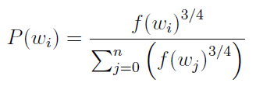
Negative sampling
The “negative samples” are chosen using a “unigram distribution”.
The probability for selecting a word as a negative sample is related to its frequency, with more frequent words being more likely to be selected as negative samples.

Slide 82
Negative sampling
The 2nd paper says that
selecting 5-20 words works well for smaller datasets,
and only 2-5 words for large datasets.

