Slide 1
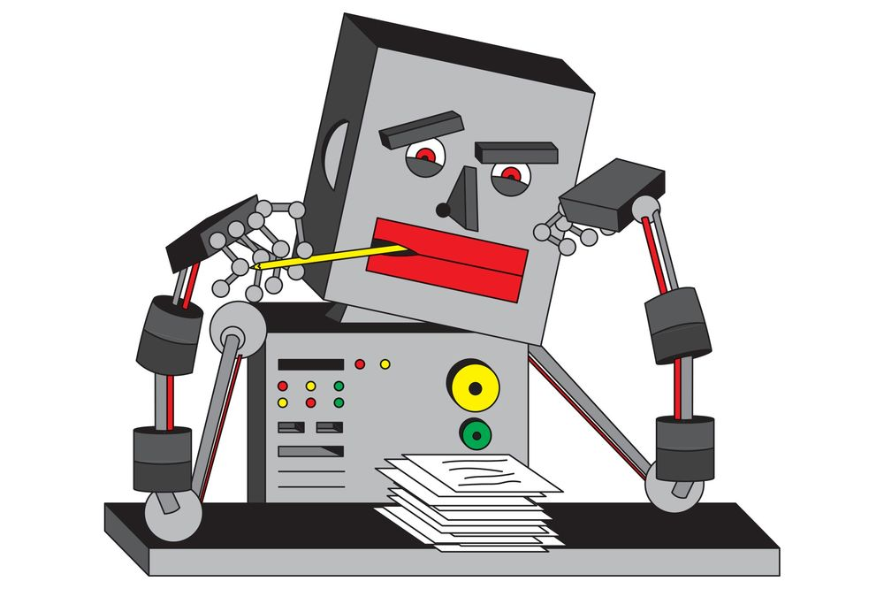
Visão geral do Aprendizado de máquina
Prof. Eduardo Bezerra
(CEFET/RJ)
ebezerra@cefet-rj.br

Slide 2
O que é Aprendizado de Máquina

Slide 3
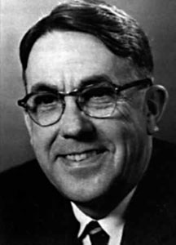
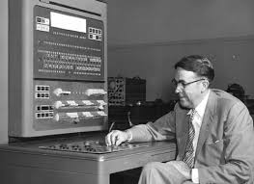
O que é Aprendizado de Máquina
Arthur Samuel (1959). “Field of study that gives computers the ability to learn without being explicitly programmed.”
Notes:
https://history-computer.com/ModernComputer/thinkers/Samuel.html

Slide 4
O que é Aprendizado de Máquina
Tom Mitchell (1998): “A computer program is said to learn from experience E with respect to some task T and some performance measure P, if its performance on T, as measured by P, improves with experience E.”
Notes:
http://www.cs.cmu.edu/~tom/

Slide 5
O que é Aprendizado de Máquina
Suppose your email program watches which emails you do or do not mark as spam, and based on that learns how to better filter spam.
Na frase acima, identifique os componentes
T
E
P

Slide 6
Tipos de aprendizado de máquina
Aprendizado supervisionado (supervised learning)
Aprendizado não supervisionado (unsupervised learning)

Slide 7
Aprendizado Supervisionado

Slide 8
Classificação vs Regressão
O aprendiz (máquina) recebe as respostas corretas.
Dois subtipos (tarefas):
Classificação: predizer valor discreto.
Regressão: predizer valor contínuo.

Slide 9
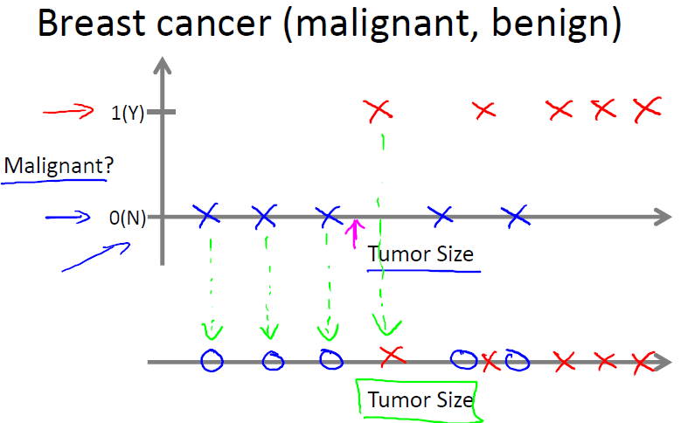
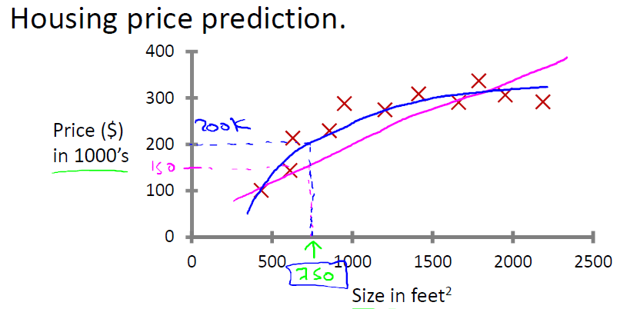
Classificação vs Regressão

Slide 10
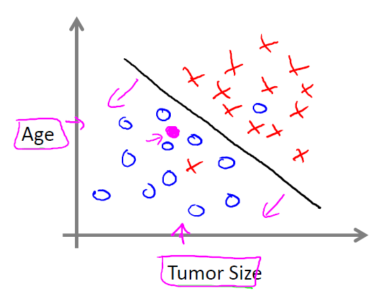
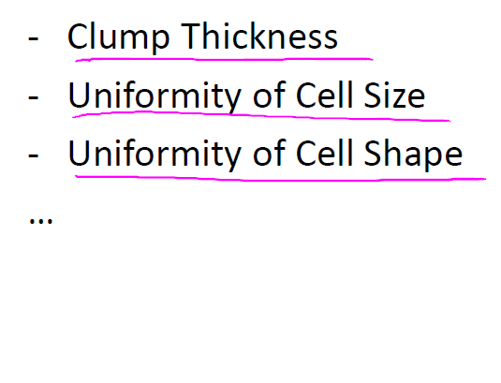
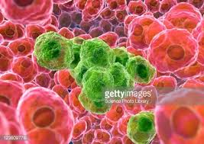
Características (features)

Slide 11
Terminologia
Training sample (training instance or training example).
Training set
Target function
Hypothesis
Model
Learning algorithm
Classifier
Notes:
https://www.quora.com/What-is-hypothesis-in-machine-learning
Training sample: A training sample is a data point x in an available training set that we use for tackling a predictive modeling task. For example, if we are interested in classifying emails, one email in our dataset would be one training sample. Sometimes, people also use the synonymous terms training instance or training example.
Target function: In predictive modeling, we are typically interested in modeling a particular process; we want to learn or approximate a particular function that, for example, let's us distinguish spam from non-spam email. The target function f(x) = y is the true function f that we want to model.
Hypothesis: A hypothesis is a certain function that we believe (or hope) is similar to the true function, the target function that we want to model. In context of email spam classification, it would be the rule we came up with that allows us to separate spam from non-spam emails.
Model: In machine learning field, the terms hypothesis and model are often used interchangeably. In other sciences, they can have different meanings, i.e., the hypothesis would be the "educated guess" by the scientist, and the model would be the manifestation of this guess that can be used to test the hypothesis.
Learning algorithm: Again, our goal is to find or approximate the target function, and the learning algorithm is a set of instructions that tries to modelthe target function using our training dataset. A learning algorithm comes with a hypothesis space, the set of possible hypotheses it can come up with in order to model the unknown target function by formulating the final hypothesis
Classifier: A classifier is a special case of a hypothesis (nowadays, often learned by a machine learning algorithm). A classifier is a hypothesis or discrete-valued function that is used to assign (categorical) class labels to particular data points. In the email classification example, this classifier could be a hypothesis for labeling emails as spam or non-spam. However, a hypothesis must not necessarily be synonymous to a classifier. In a different application, our hypothesis could be a function for mapping study time and educational backgrounds of students to their future SAT scores.

Slide 12
Algumas aplicações
Detecção de spam
Reconhecimento de Voz

Slide 13
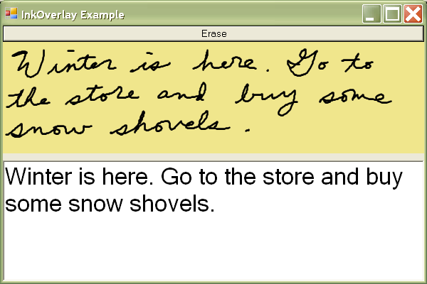
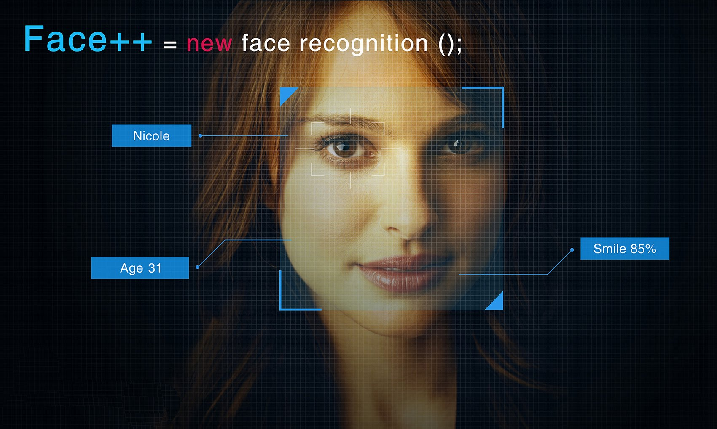
Algumas aplicações (cont.)
Reconhecimento de imagens
Reconhecimento de caracteres

Slide 14
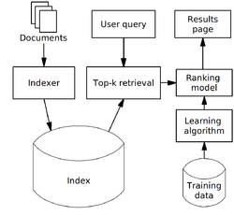
Algumas aplicações (cont.)
Tradução Automática
Learning to rank
Notes:
https://en.wikipedia.org/wiki/Learning_to_rank
Alternatively, training data may be derived automatically by analyzing clickthrough logs (i.e. search results which got clicks from users),[3] query chains,[4] or such search engines' features as Google's SearchWiki.

Slide 15
Aprendizado Não Supervisionado

Slide 16
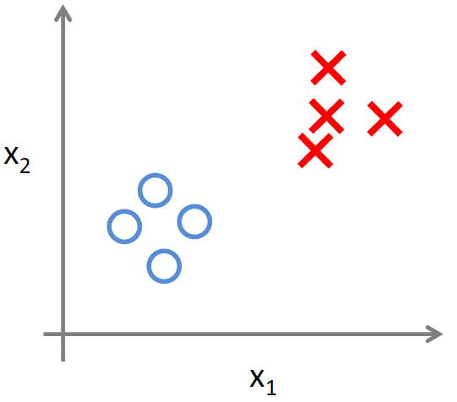
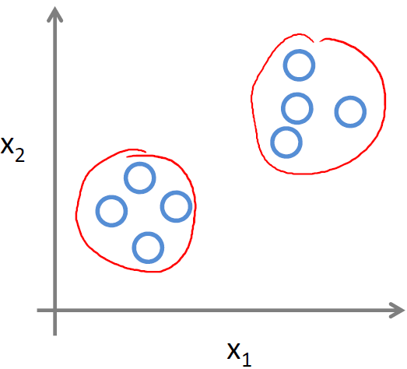
Aprendizado Não Supervisionado

Slide 17
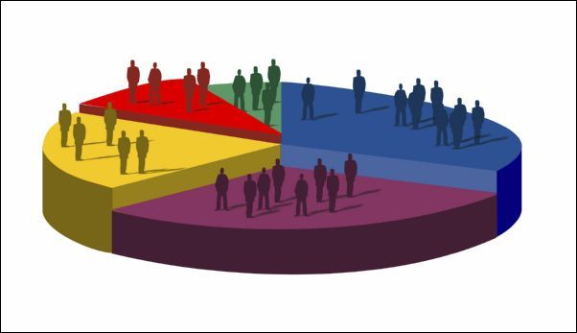
Algumas aplicações
Segmentação de mercado

Slide 18
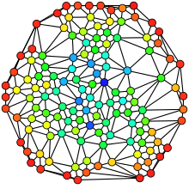
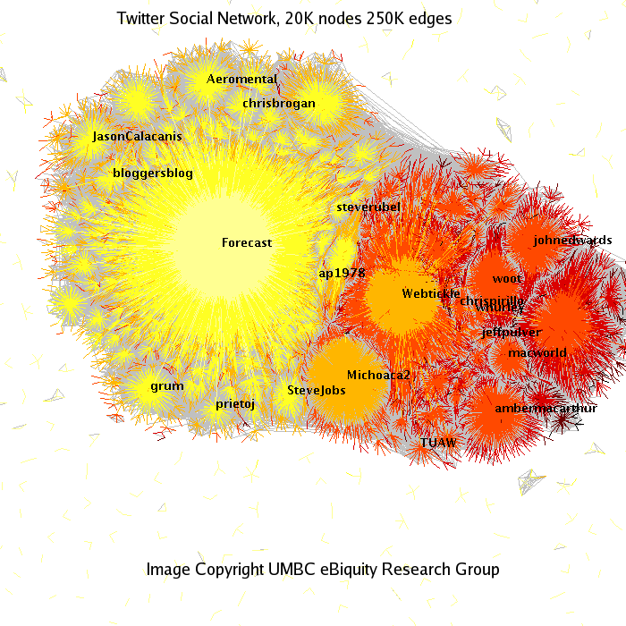
Algumas aplicações (cont.)
Análise de Redes Sociais

Slide 19
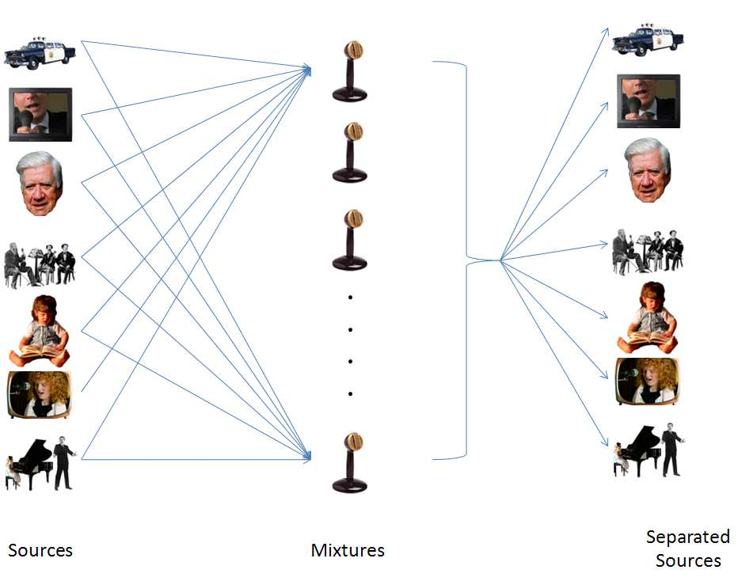
Algumas aplicações (cont.)
Cocktail party problem
Notes:
http://cnl.salk.edu/~tewon/Blind/blind_audio.html

Slide 20
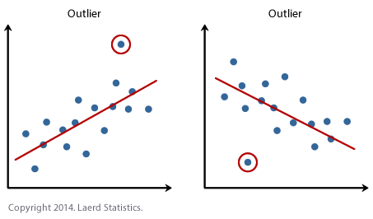
Algumas aplicações (cont.)
Detecção de valores extremos (outlier detection)

